Slide 1

Adverse Childhood Experiences

Slide 2

ACEs
Abuse
Neglect
Witnessing violence
Parental substance abuse
Parental mental illness
Parental stress (divorce, separation)
Parental criminal behaviors
Additional stressors: bullying, sibling violence, poverty
https://www.youtube.com/watch?v=ccKFkcfXx-c

Slide 4
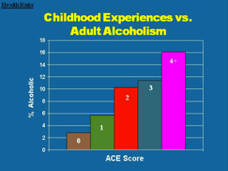
Health Outcomes
Biological: Heart disease, cancer, lung disease, liver disease, etc.
Psychological: Depression, anxiety, sleep disturbance, memory problems, poor anger control, stress, etc.
Behavior: Obesity, smoking/substance use, early sexual experiences, teen pregnancy, etc.
Relational problems, marriage to alcoholic, domestic violence, etc.

Slide 5
How ACEs lead to negative health outcomes
How can things that happen at an early age (might not even remember) affect our lives?
Disruption of neurodevelopment --> lasting effects on brain structure and function
Exposure to stressful events on developing brain →immune system impact
https://www.youtube.com/watch?v=LmVWOe1ky8s

Slide 6
Positive Adaptions after ACEs
Resilience is a positive adaption: absence of psychopathology or presence of competence despite exposure to adverse life experiences.
What decreases the prevalence of ACEs or how do you help children cope with ACES?
  Interventions that support mental health of caregivers
  Programs delivered in school settings
  Primary care promoting child health

