Slide 1
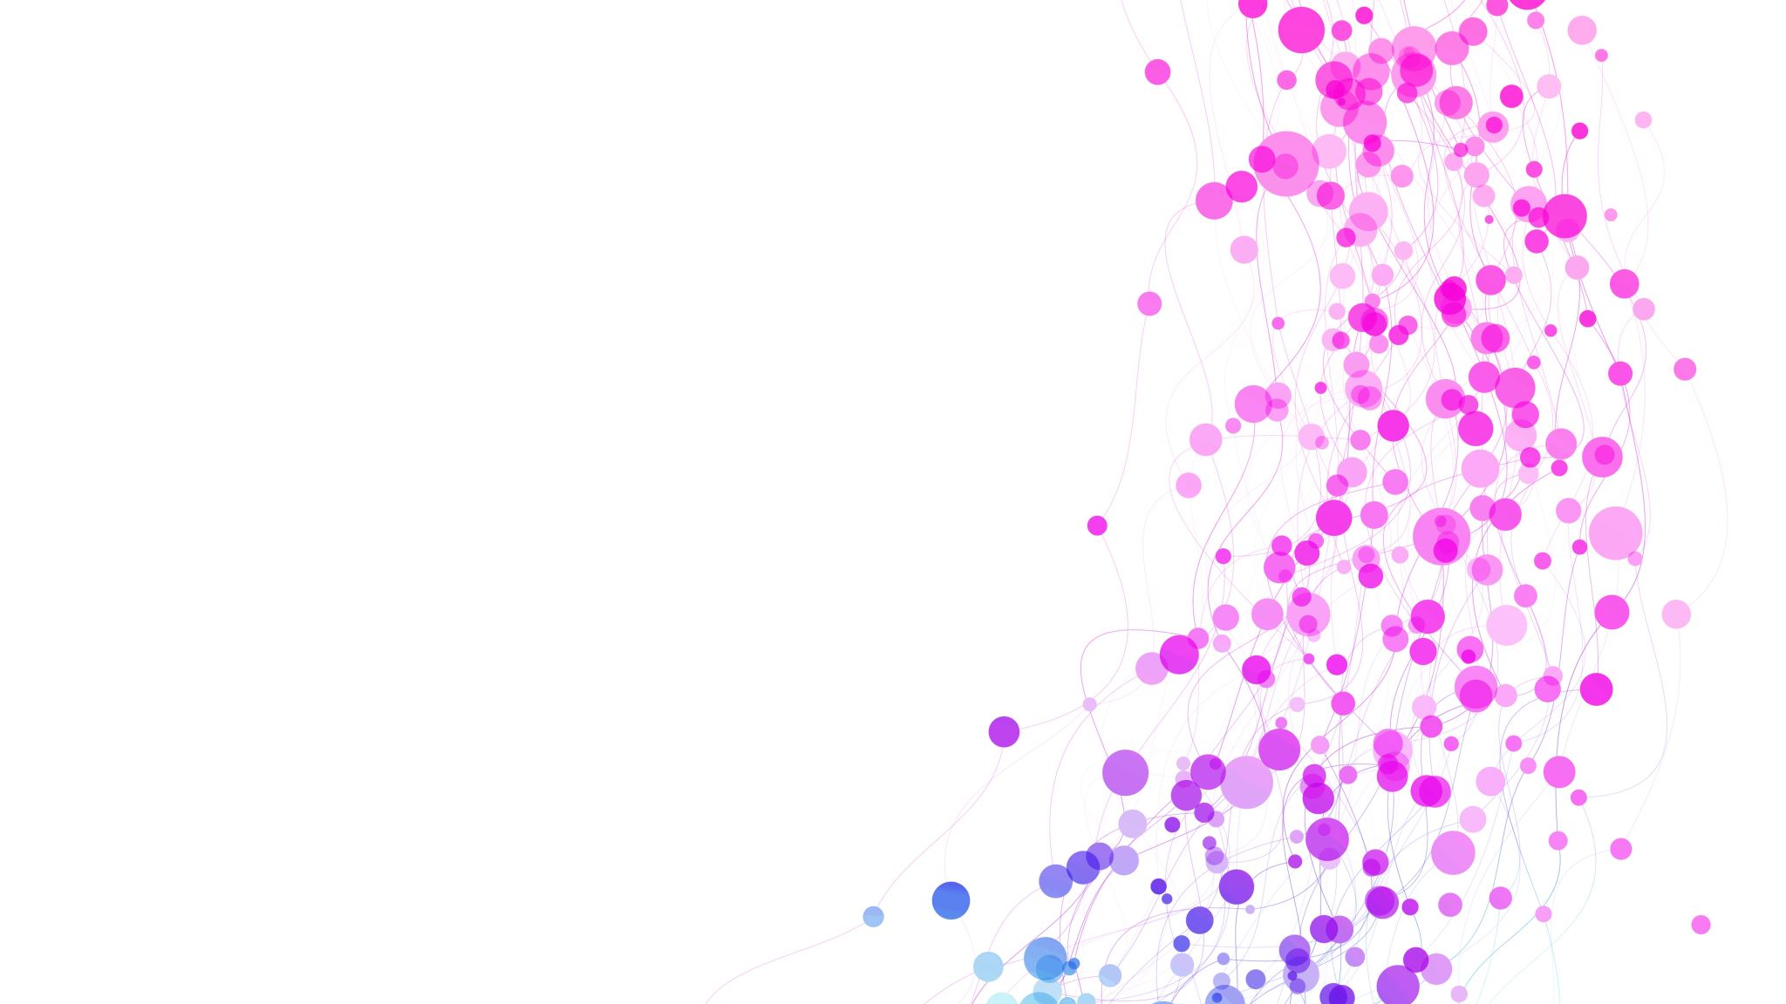
Susceptibility

Slide 2
Susceptibility
Genetics
Adverse Childhood Experiences
Adolescent Drug Use
Mental Illness & Personality
Peers, Family, & Culture

Slide 3
Adolescent Drug Use

Slide 4
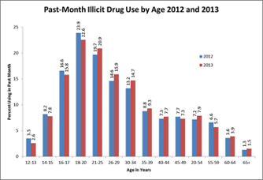
Susceptibility
Why do so many adolescents use drugs?
Why does adolescent drug use lead to addiction so easily?
85-90% of SUD started before 18, disorder by 20
Drink at 14: 15% develop alcoholism
Drink at 21: 2% develop alcoholism
Taking prescription drugs at 13 or younger 25% develop SUD in life

Slide 5
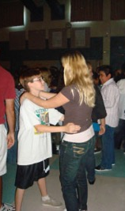
Physical Development
Physical development in adolescence
Early maturing girls: SUD, mood, eating disorders
Early maturing boys: SUD, delinquency, sexual activity
Late maturing boys: depression, parental conflict, victim (bullying)
Physical development -> role in WHEN someone decides to use

Slide 6
Social Development
Social development in adolescence
Peers > Family, values, morals, judgments. Defining self.
Positive peer relationships = positive psychosocial adjustment
Negative peer relationship = delinquent behaviors
Attachment and family closeness: associated with low delinquency

Slide 7
Identity Development
Identity development in adolescence
Self-esteem: gap between self-concept and what you “should” be
Peers are reference point
Experiment -> settle into an identity

Slide 8
Cognitive and Emotional
Cognitive/emotional development in adolescence
Effort to exert independence and autonomy
Impulsive
Egocentric
Emotional dysregulation
Peer pressure
Illusion of Invulnerability
Personal fable

Slide 9
Return to Questions
Why do so many adolescents use drugs?
Why does adolescent drug use lead to addiction so easily?
Physical development
Social development
Identity development
Cognitive & Emotional development
.??

Slide 10
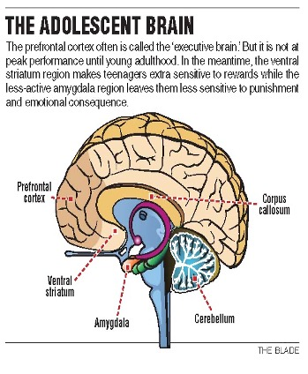
Brain Development
Brain development in adolescence
Prefrontal cortex not fully formed; controlling impulses, anticipating consequences. Underactive.
Reward pathway/striatum: overactive (dopamine) https://www.youtube.com/watch?v=LWUkW4s3XxY
DNA is vulnerable to outside factors https://www.youtube.com/watch?v=UNAbf3J3lR0

