Slide 1

Why does addiction persist over time? Why is it so hard to overcome?

Slide 2
What we will cover
Reinforcement
Cravings
Brain Changes
Tolerance & Withdrawal
Motives, Expectancies, etc.
Peers, Family, & Culture

Slide 3
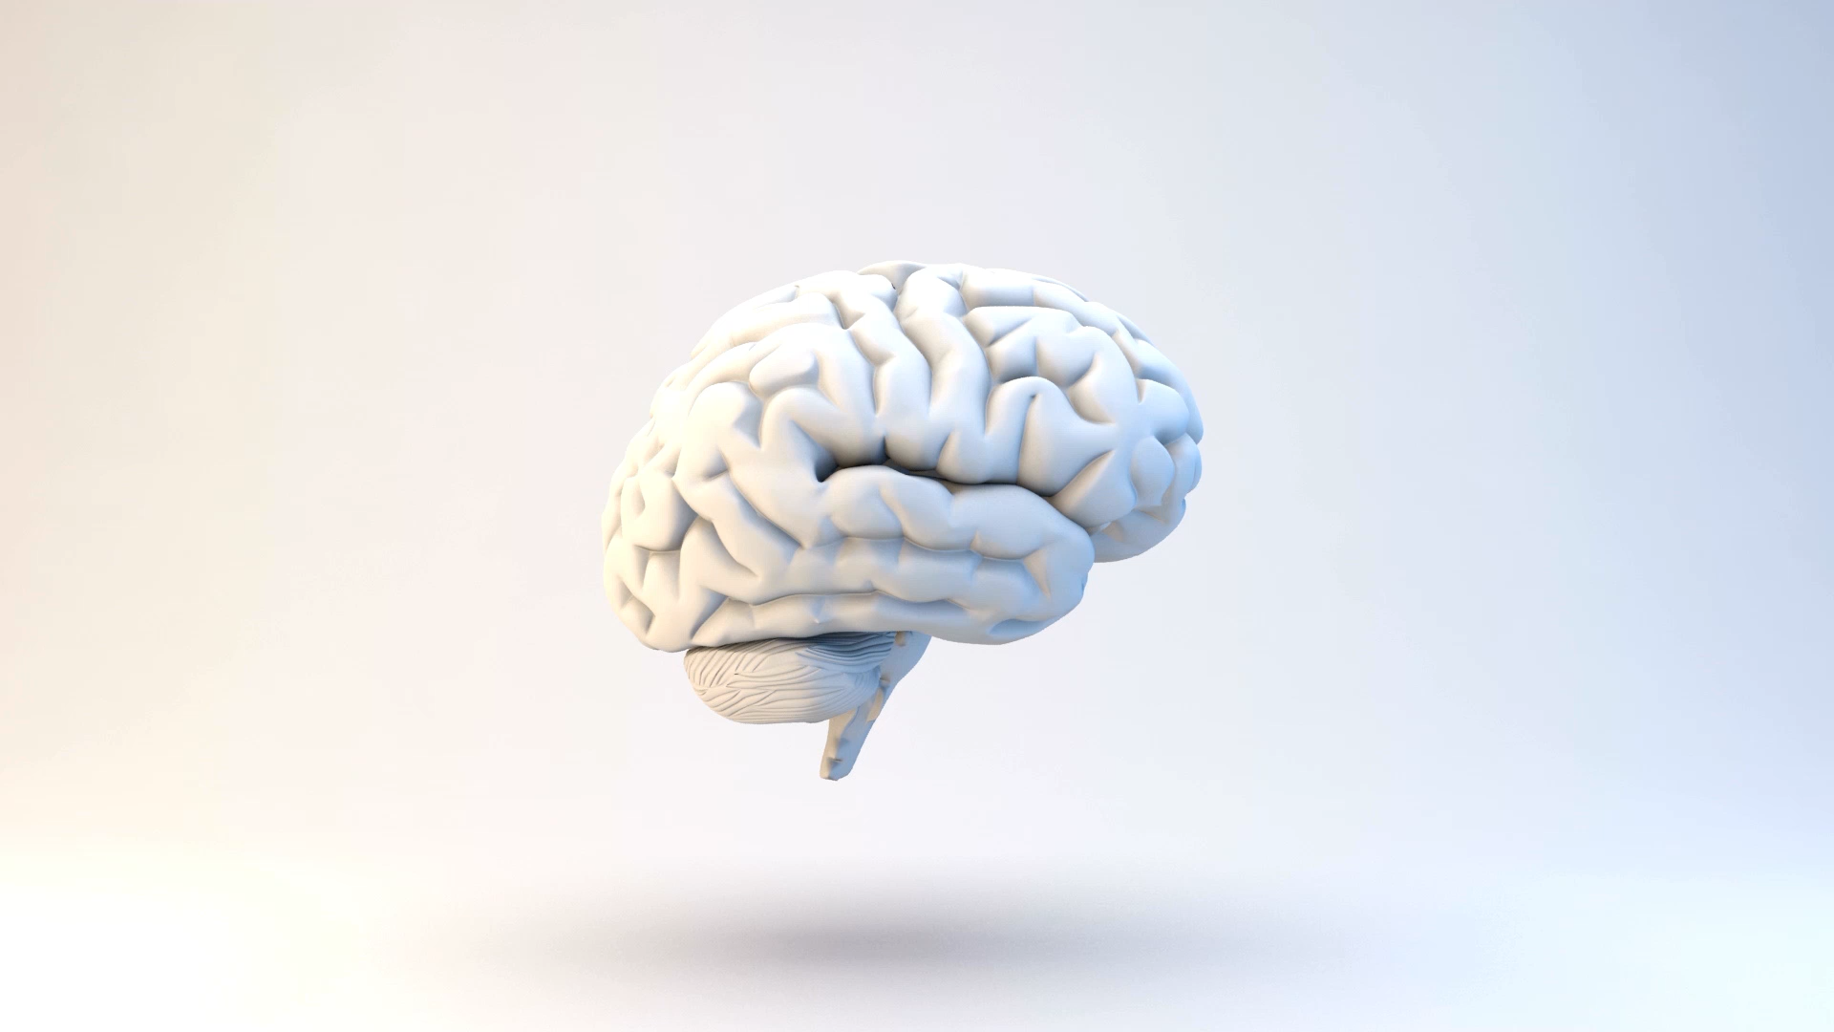
A Deeper Look inside the Brain

Slide 4
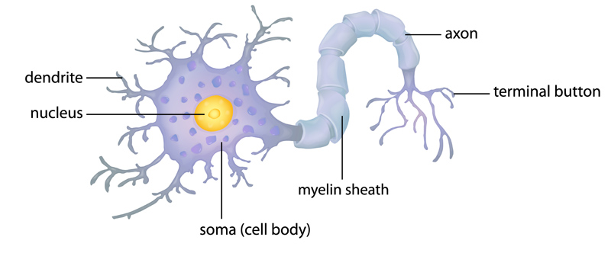
Neuronal Structure

Slide 5
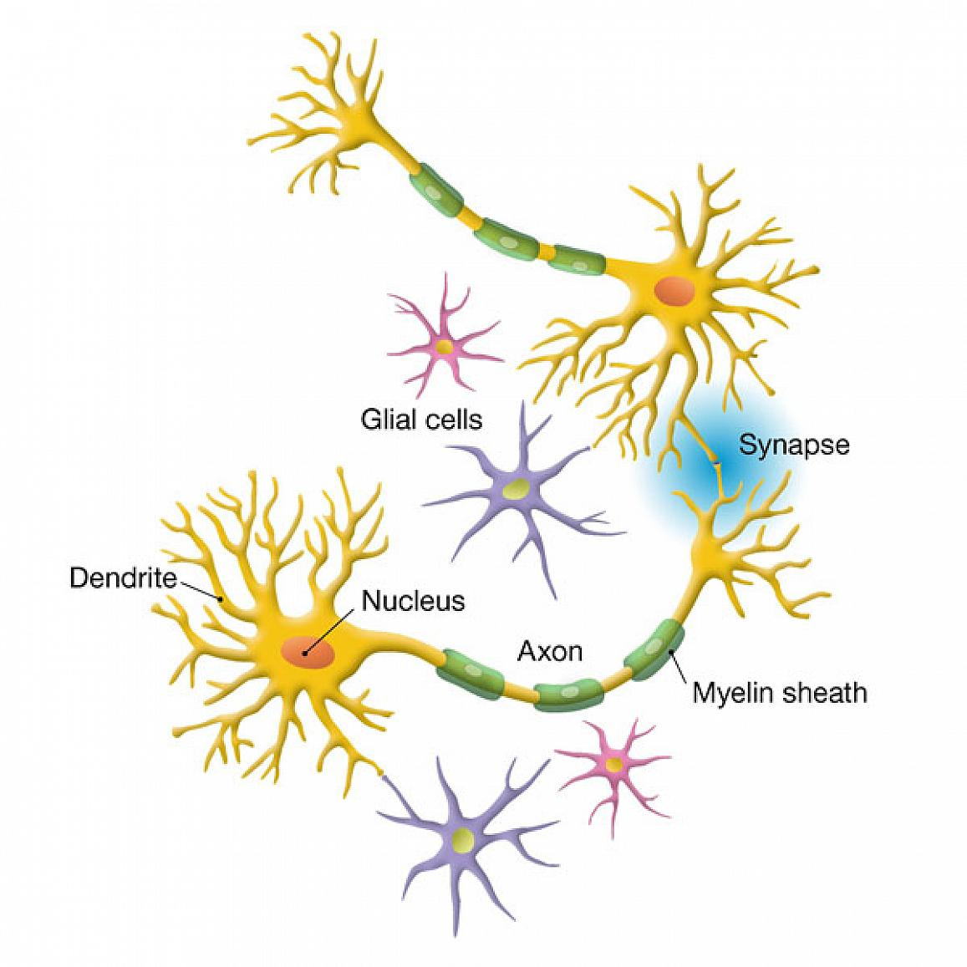
Communication Between Neurons

Slide 6
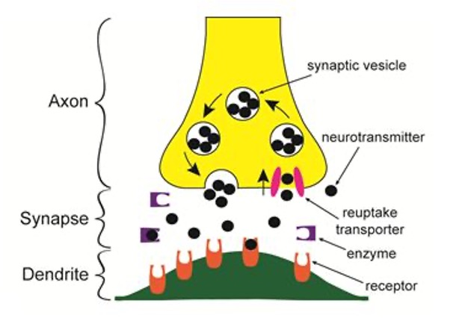
Neurotransmitters in the Synapse
http://www.youtube.com/watch?v=p5zFgT4aofA

Slide 7
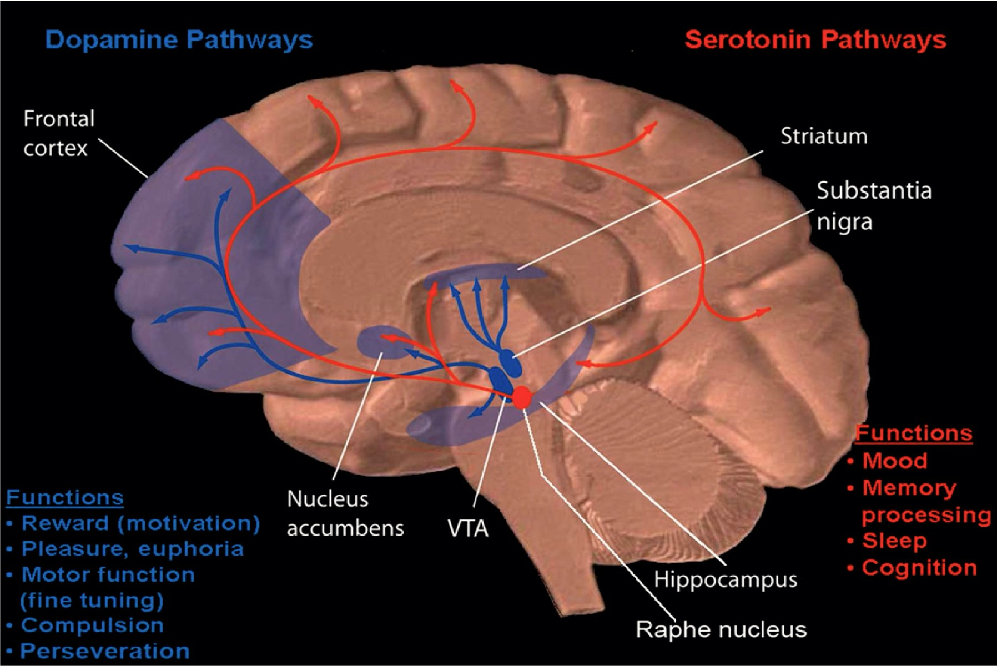
Neuronal Pathways

Slide 8
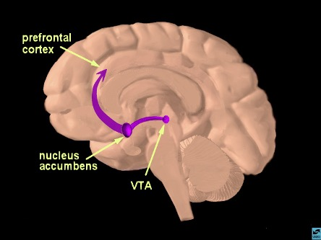
The Reward Pathway

Slide 9
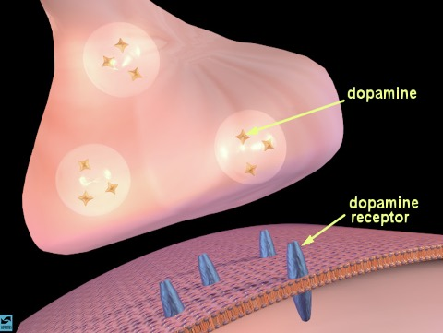
Synaptic Neurotransmission

Slide 10
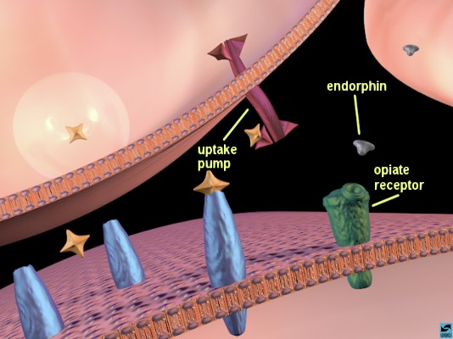
Dopamine Neurotransmission

Slide 11
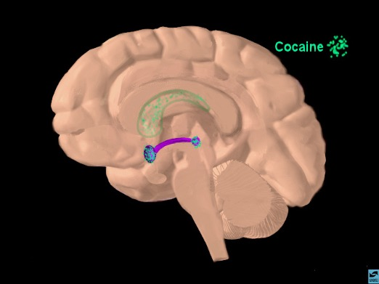
Localization

Slide 12
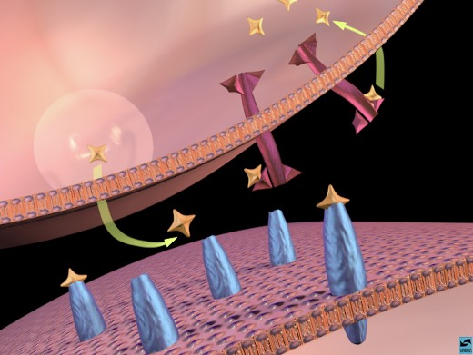
Dopamine Binding to Receptors and Uptake Pumps

Slide 13
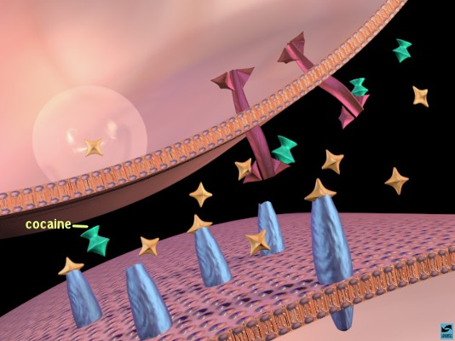
Cocaine Binding to Uptake Pumps

Slide 14
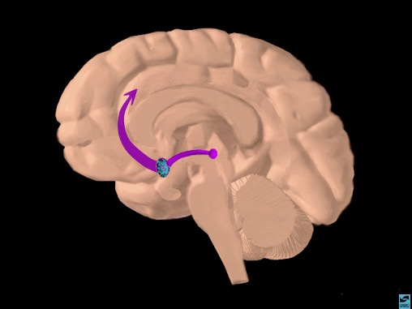
Cocaine Activation of Reward Pathway

Slide 15
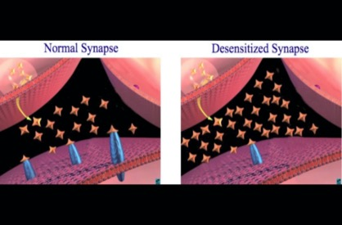
Overuse = Changes in Reward Center
No longer able to feel the benefits of natural rewards and can’t function normally without the drug present

Slide 16
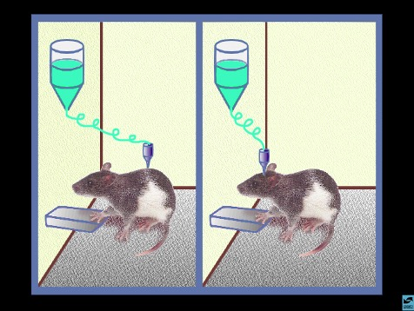
Mouse Party
http://learn.genetics.utah.edu/content/addiction/mouse/

Slide 17
Dopamine Increased Release
Food = 50% increased release
Sex = 100% increased release
Cocaine = 300% increased release
Crystal Meth = 1200% increased release
Rawson et al., 2000

