Slide 1
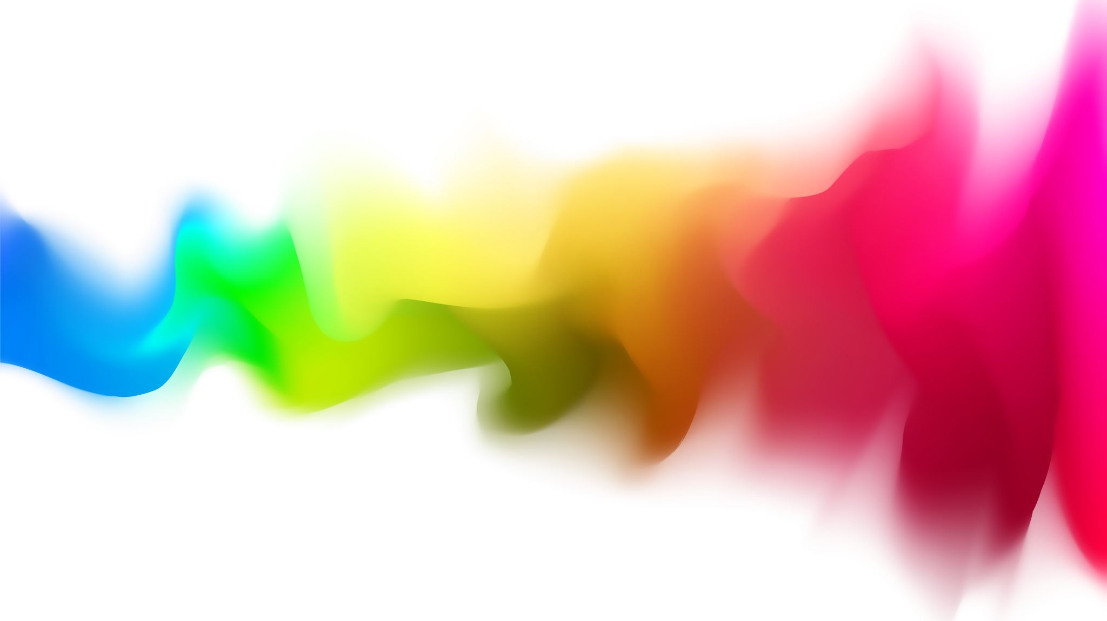
Why does addiction persist over time? Why is it so hard to overcome?

Slide 2
What we will cover
Reinforcement
Cravings
Brain Changes
Tolerance & Withdrawal
Motives, Expectancies, etc.
Peers, Family, & Culture

Slide 3
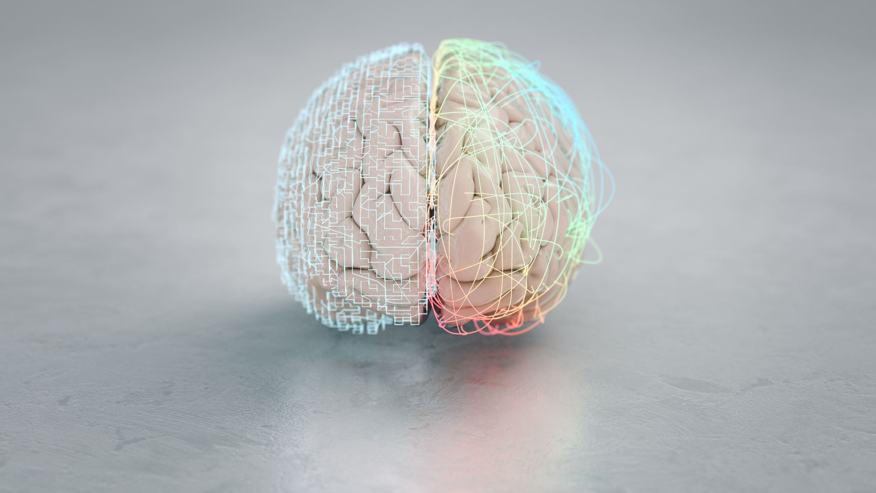
Brain Changes

Slide 4
Brain Regions involved in Addiction
Develops back (brainstem area) to front
Primitive =
Cortex (outermost layer) responsible for planning ahead and inhibition

Slide 5
Brain Regions involved in Addiction
Limbic system:
Emotions, memory, and arousal.
Ventral Tegmental Area (VTA): midbrain
Excitation and motivation
Notes:
VTA is survival

Slide 6
Brain Regions involved in Addiction
Limbic system brain structures:
Ventral striatum (accumbens): motivation and desire
Dorsal striatum: habit formation and compulsion.
Amygdala: emotions (anxiety, irritability, etc.)

Slide 7
Brain Regions involved in Addiction
Prefrontal cortex: top of limbic system
More sophisticated: makes decisions, prioritizes tasks, evaluates consequences, and regulates impulses.
Notes:
PFC - Prefrontal Cortex

Slide 8
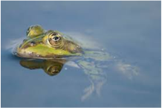
The Reward Pathway
Unexpected, robust reward ->
VTA sends dopamine to the nucleus accumbens

Slide 9
Ventral Striatum
Desire, anticipation, cravings, & motivation
Past pleasure -> present desire
Receives signal and motivates attention and behavior to get the reward.

Slide 10
Dorsal Striatum
Compulsive behavior and habit formation
Not concerned with reward, just wants to repeat behavior
Reward-driven becomes compulsive behavior
Desire to chronic compulsivity

Slide 11
Orbitofrontal Cortex
Part of PFC that connects to the limbic system.
“Bridge” btwn emotional limbic system and logical PFC
It judges outcomes of decisions and compares to internal states.

Slide 12
Orbitofrontal Cortex
Over time in severe addiction the bridge thins, and the person has inability to change behaviors that were once rewarded, even with bad consequences.
Cue that drug is near -> nucleus accumbens drives seeking -> PFC doesn’t stop them
PFC becomes less active and loses volume (20%) due to atrophy
https://www.youtube.com/watch?v=1G93lz-JK-E
Notes:
The atrophy occurs in the bridge between the Orbitofrontal PFC, so you're unable to use the checks and balances the brain provides due to the message to being construed. You’re really only able to deliberate the choice to utilize substances for 15 seconds before the choice to use it during severe SUD.

Slide 13
Step by Step
Initial drug use involves impulsivity
Experiences positive sensation when using, rewards registered in nucleus accumbens and increase flow of dopamine
Associations due to classical conditioning: future cues release dopamine (VTA to ventral striatum) – Create anticipation and motivation to seek it

Slide 14
Step by Step
Reward/reinforcement diminishes with repeated use due to tolerance and withdrawal
Focus is now escaping negative feelings produced by the amygdala
Impulsivity shifts to compulsivity: dorsal striatum strengthens drug seeking habits and promotes compulsive use even without rewards
Disruptions in the PFC happen because of thinning of the orbitofrontal cortex, making it extremely difficult to stop using and makes relapse more possible if someone stops using.

Slide 15
Step by Step
Example:
https://www.youtube.com/watch?v=4T1F1UfXf_8

