Slide 1
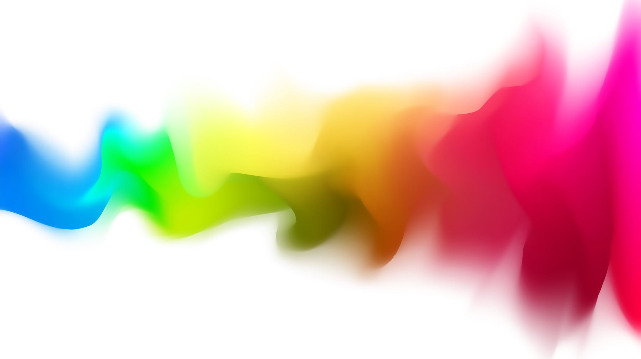
Why does addiction persist over time? Why is it so hard to overcome?
Notes:
Alcohol withdrawal vs. opiate withdrawal
Last class, operant conditioning, reinforcement, schedules of reinforcement.

Slide 2
What we will cover
Reinforcement
Cravings
Brain Changes
Tolerance & Withdrawal
Motives, Expectancies, etc.
Peers, Family, & Culture

Slide 3
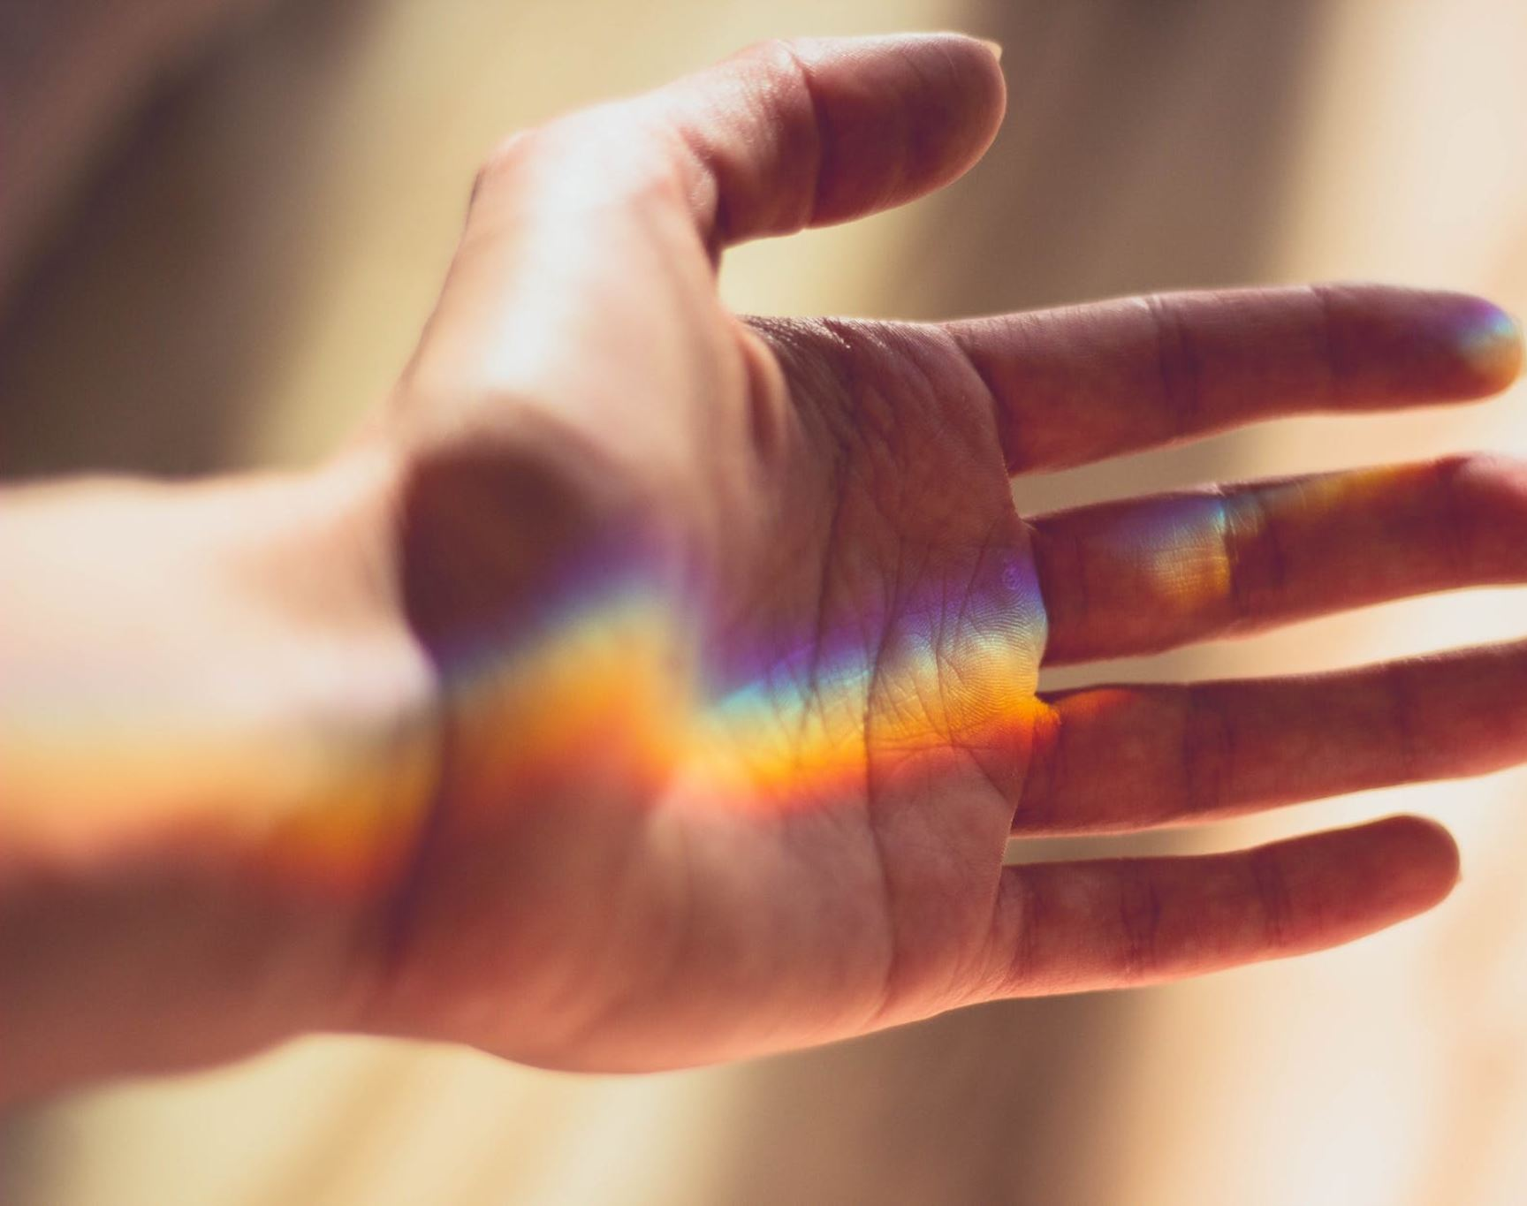
Cravings

Slide 4
Cravings
Addicted ->Cravings ->Motivation
Cravings occur:
Body needs it for physical dependence
Cues and signals in environment remind, get excited
This Photo by Unknown Author is licensed under CC BY

Slide 5
Cravings- Environmental Cues
James
Erica

Slide 6
Classical Conditioning
To learn more about cravings we turn to a concept called classical conditioning.
Learning process when two stimuli are repeatedly paired.
https://www.youtube.com/watch?v=hhqumfpxuzI

Slide 7
Classical Conditioning
The bell makes the dog salivate and it also tells the dog that food is near! A craving!!

Slide 8
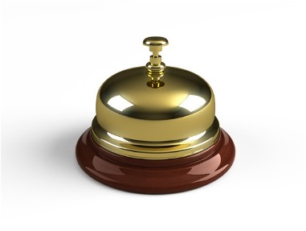
Classical Conditioning
Stimulus generalization and stimulus discrimination
Does Pavlov’s dog salivate to other bells?
Can they differentiate between a bell for food and other bells don’t mean food?

Slide 9
Cravings
James
It is now summer and he has a job. When the workday ends, does he think about MJ?
Erica
When she is a passenger, does she have the urge to vape?

Slide 10
Cravings
Associations are made between drug use and emotional/internal states.
Drink when feeling down
Uses drugs after a fight with parents
Uses marijuana when he can’t sleep
32 percent of relapses occurred after negative emotional states
32 percent followed negative physical states not characterized by withdrawal-like symptoms,
16 percent followed withdrawal-like states,
5 percent followed positive emotional states
(Chaney, Roszell, and Cummings, 1982).

Slide 11
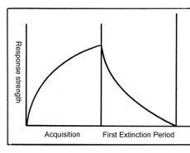
Cravings
Can you ever get past these cravings?
Extinction is when the “power” of the cue/stimulus is reduced and no longer causes cravings.

Slide 12
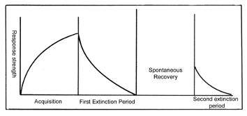
Cravings
Can you ever get past these cravings?
Spontaneous recovery: no longer has association -> bell comes back -> salivation comes back

