Slide 1
Different perspectives on addiction

Slide 2
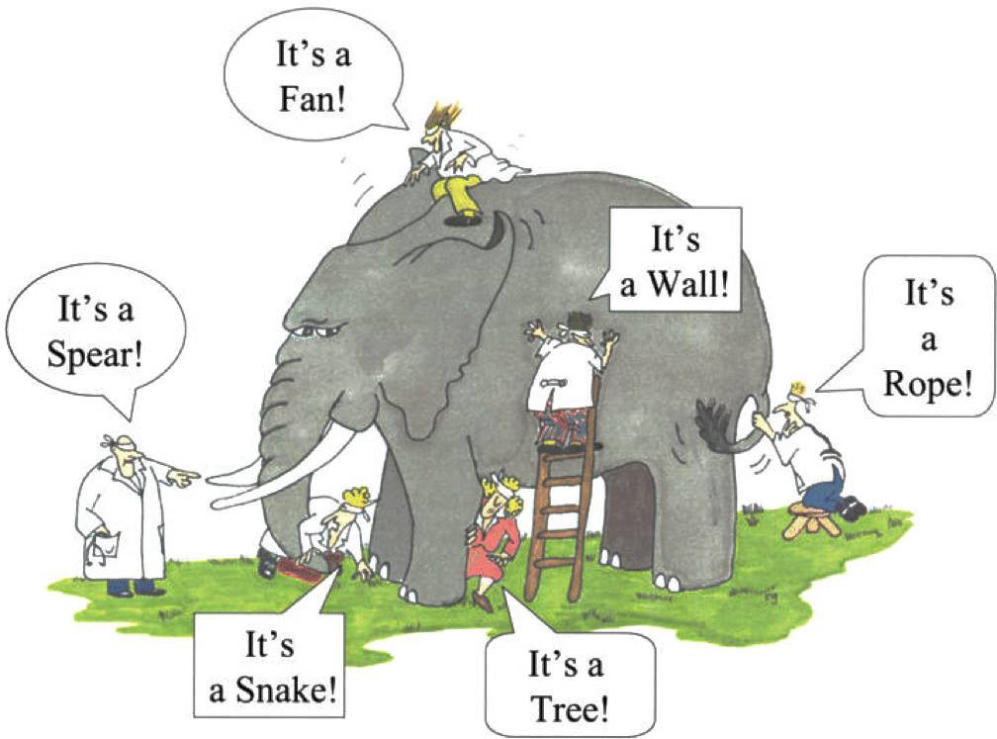

Slide 3

Moral Model
Morally deficient, irresponsibility, sinful, evil
Behavior is freely chosen
Condemn and punishment
Old, outdated
Contributes to stigma

Slide 4
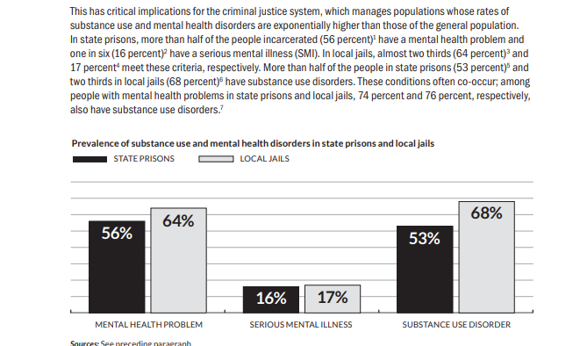
SUD and SMI in prisons and jails

Slide 5

Disease Model
Jellink 1930’s: Alcoholics Anonymous
Physical, mental, and spiritual disease
Spiritual malady -> physical allergy -> mental obsession
Primary disease rather than secondary
Progressive, chronic, incurable
Recovery vs recovered

Slide 6
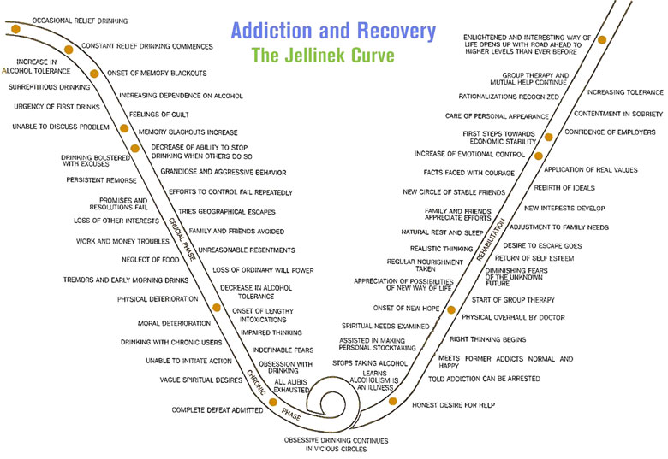

Slide 7
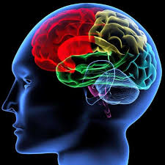
Medical Model (biological)
Genetically predisposed for addiction
Tolerance -> more use -> withdrawal
Altered brain functioning
  Brain disease
  Reward and decision-making

Slide 8
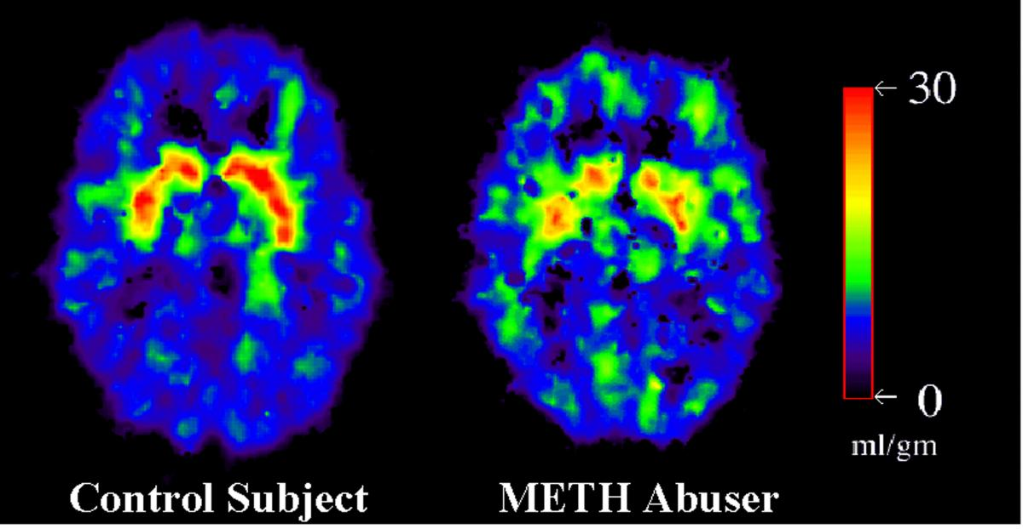
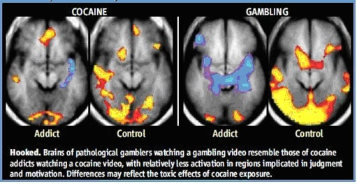
Brain Changes

Slide 9
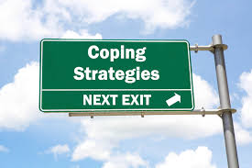
Psychological Model
Psychological factors
  Coping: SUD is secondary and used to cope with underlying problem
  Learning: classical and operant conditioning and observational learning
  Cognition: expectancies, delay discounting

Slide 10
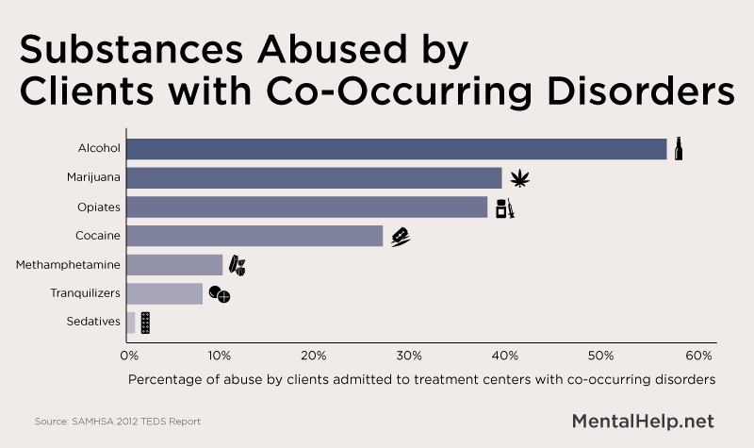
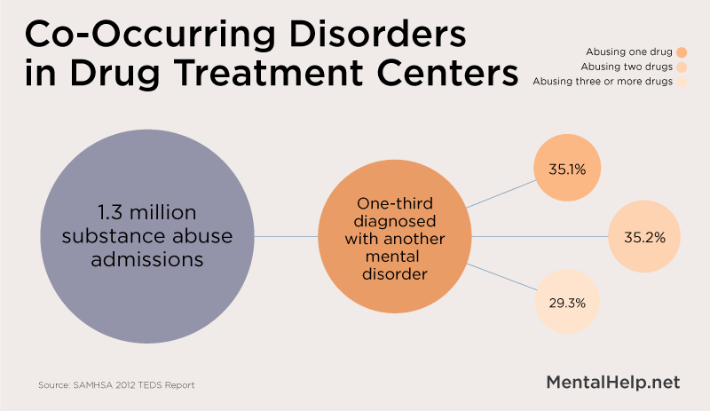

Slide 11


Family Model
Family Disease Model : family shares disease.
  Codependence, enabling, and roles
Family Systems Model : Intergenerational transmission

Slide 12
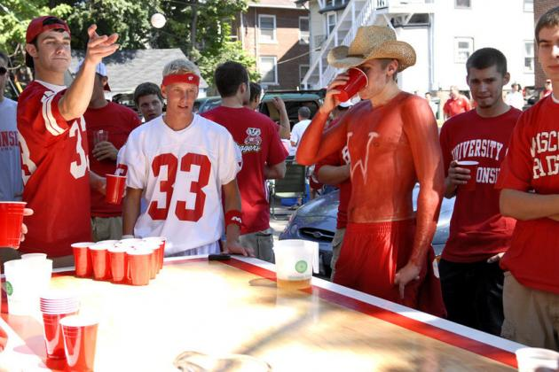
Sociocultural Model
Social/Environmental factors (culture, family, and peers) influence substance use.
Environment/culture -> first use and type of substance
Peers/Society ->acceptance of use
SES, oppression, and discrimination influence addiction trends

Slide 13
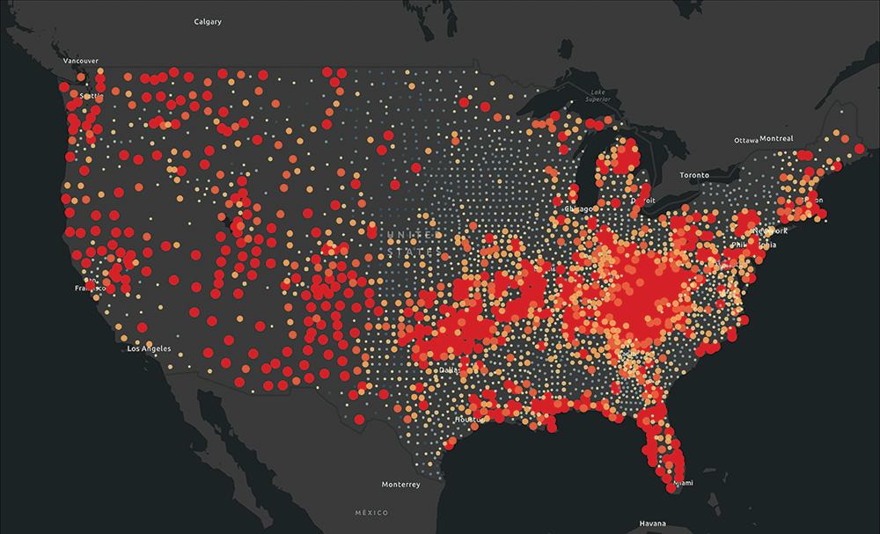

Slide 14
Multi-causal Models
Multi-causal: describe the complex interplay of factors
Biopsychosocial Model: factors combine and interact to influence physical/mental health
The Addiction Syndrome Model: type of biopsychosocial explains the development and continuation of addiction

Slide 15
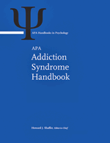
Addiction Syndrome Model
Describes how bio, psych, and social factors influence the development of addiction.
All addictions have:
  Risk factors
  Brain changes
  Chronic and relapsing course

Slide 16
Addiction Syndrome Model
“when a reward is present, a risk of addiction exists”
“reward deficiency syndrome” - incessant seeking (craving) and performing, losing control, and continuing despite negative consequences.
The risk is higher with bio, psych, and social risk factors

