Slide 1
Gambling Addiction

Slide 2
Gambling Addiction
Gambling is to play games of chance for money or other rewards.
Goal: risk something of value with the hope of increasing wealth or status.
Reality: based on certainty the gambler will lose more than they win.

Slide 3
Gambling addiction
Gambling Disorder
DSM-5
Same chapter as SUD
Only behavioral addiction listed in the SUD chapter
Internet Gaming D/O is in the appendix now.

Slide 4
Diagnostic criteria
Persistent and recurrent problematic gambling behavior leading to clinically significant impairment or distress and some of these symptoms:
Increasing $ to get excited, irritable when cutting back, repeated efforts to cut back, gambling on the mind, gambles to cope, after losing returns to get even, lies to conceal, jeopardizes relationships, & needs money to relieve financial burden.

Slide 5
Gambling addiction
Insidious onset – often starts as an enjoyable pastime and then escalates into compulsion.
Increasing: problem gambling, % of women gamblers, & % of older adults.
Why? New forms of gambling, increased access, internet gaming, lotteries, spread of casinos, etc.

Slide 6
Gambling addiction
Irresistible urges, compulsive activity
Tolerance: having to up the stakes to get the same rush
Withdrawal: negative physical sensations upon stopping behavior (headaches, insomnia, etc.)
Out of control: plan to use a certain amount of money, but can’t adhere to your rule
Continue despite negative consequences

Slide 7
A secretive illness
Masters of hiding their activities
No obvious signs of intoxication
Not where they said, missing money, miss family commitments, etc.
Often spouses not aware, or think affair
Irritable, defensive, violent, depressed
Brenda’s story:
http://www.youtube.com/watch?v=rzfrV3WcXMM
http://www.youtube.com/watch?v=wiQ5nZ6gyIY
http://www.youtube.com/watch?v=EOuYGSipH0M

Slide 8
Gambling addiction
Severe depression and suicide ideation is common with gambling addictions.
Debt, damage to relationships, etc.
Downward spiral is non-linear:
They will lose, then win, then lose
Belief that the next bet may be the one that gets them out of debt.
Even if they won that they would continue to gamble

Slide 9
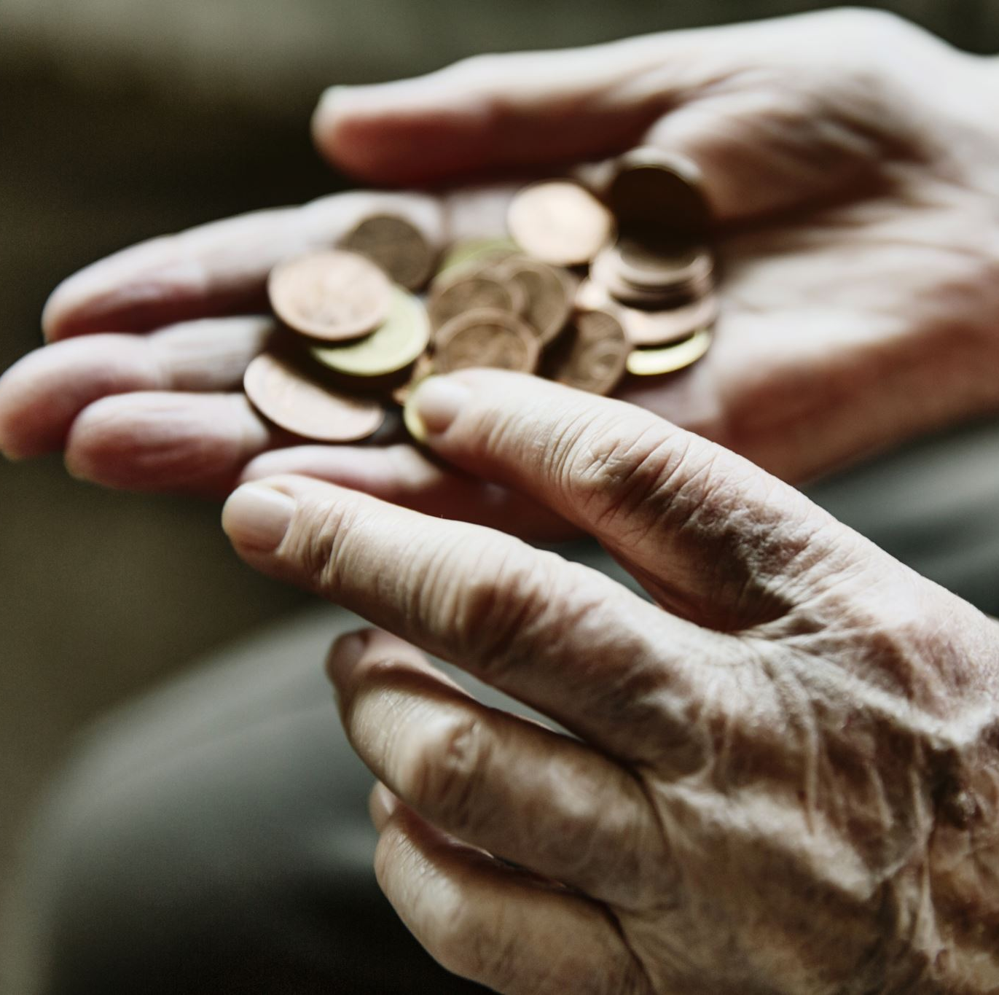
Addiction to money???
No, it is an addiction to the EXPERIENCE. Money is just the delivery system for the gambling addiction.
The near miss, the chasing, the “zone”
Anticipations and “near misses”
https://www.youtube.com/watch?v=BF5SzIN63w8

Slide 10
Cognitive distortions
Gambler’s fallacy
Flip a coin 5x, what will happen on the 6th?
Misunderstanding of randomness
Lottery numbers in sequence or in a pattern
Illusion of control
Blowing on the dice, strategy at the slots
https://www.youtube.com/watch?v=QH1iTGnPQH4

Slide 11
Automaticity
Fugue-like state where they find themselves engaging in unplanned, spontaneous gambling activity.
Once compulsions triggered -> in a trance, only broken when experience ends.
Gambling binge = like a blackout; lose sense of time, unaware of money spent, disoriented, despair, & depression.

Slide 12
Action gamblers
On a high, rush
Starts with the first big win
Mostly males, views gambling as a skill to be learned, feel powerful and special, tend to play skill games (i.e. poker or blackjack), narcissist, anti-social
Fluctuate between extreme confidence to self-doubt
Workplace signs: late, long lunches, etc.

Slide 13
Escape gamblers
Seek numbing and trance-like state, seeks sedation and anonymity, escape from the daily
More commonly women, become friends with casino staff, have favorite machines
Begins much later in life, no significant wins in their history
Not the excitement -> more of a relief
Slot machines and lotteries

