Slide 1
Susceptibility: What puts someone at risk of developing an addiction?

Slide 2
Susceptibility
Genetics
Adverse Childhood Experiences
Adolescent drug use
Mental Illness and Personality Traits
Peer Groups and Family

Slide 3
Genetics

Slide 4
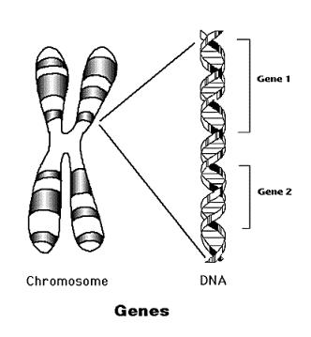
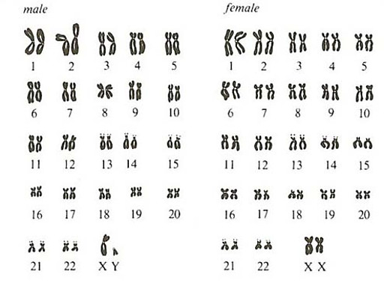
Genetics
From Mother
From Father
Here they are arraigned in homologous pairs – “matched” chromosomes, one from mother, one from father

Slide 5
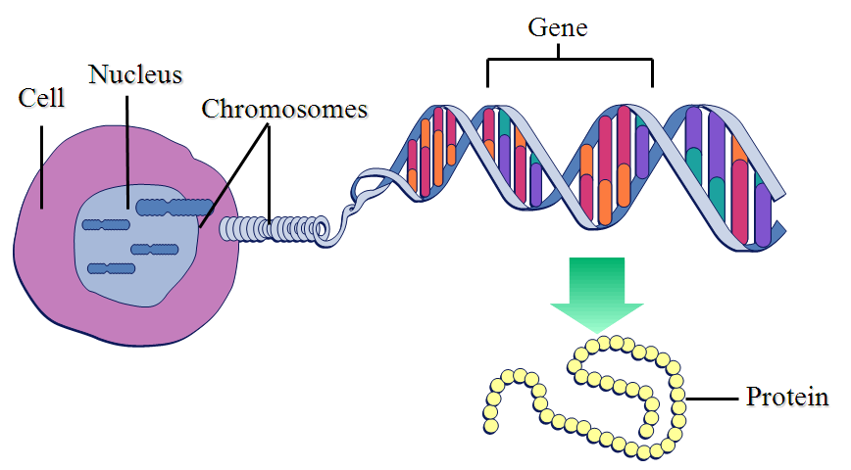
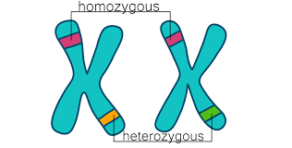
Genetics
Genes -> segment DNA
Instructions
Each gene is on a chromosome in two alleles, one from each parent
https://www.youtube.com/watch?v=C8OL1MTbGpU

Slide 6
More on Genetics
Polygenic – trait controlled by more than 1 gene
Height, skin color, hair, eye color, etc.
Do you think addiction is polygenic?

Slide 7
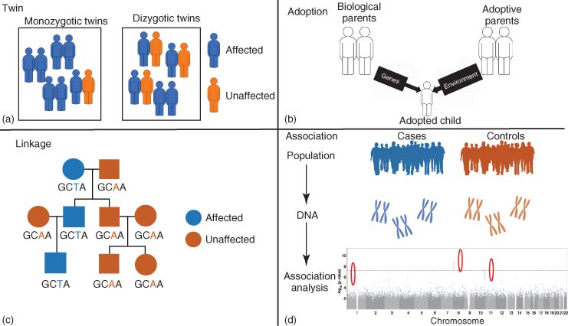
Behavioral Genetics
video

Slide 8
Twin Studies – Concordance Rates
 | Identical Twins | Fraternal Twins
Criminality | 50% | 20%
Alcoholism | 55% | 30%
Sexuality | 50% | 20%
Depression | 45% | 25%
Autism | 60+% | 5-10%
Intelligence | 85% | 55%
Schizophrenia | 45% | 15%
Cancer | 16% | 13%
Diabetes | 50% | 10%

Slide 9
Genome-wide Association Study GWAS
Can identify subtle variations in DNA
With and without the disease
Identify places on DNA that differ by a single letter

Slide 10
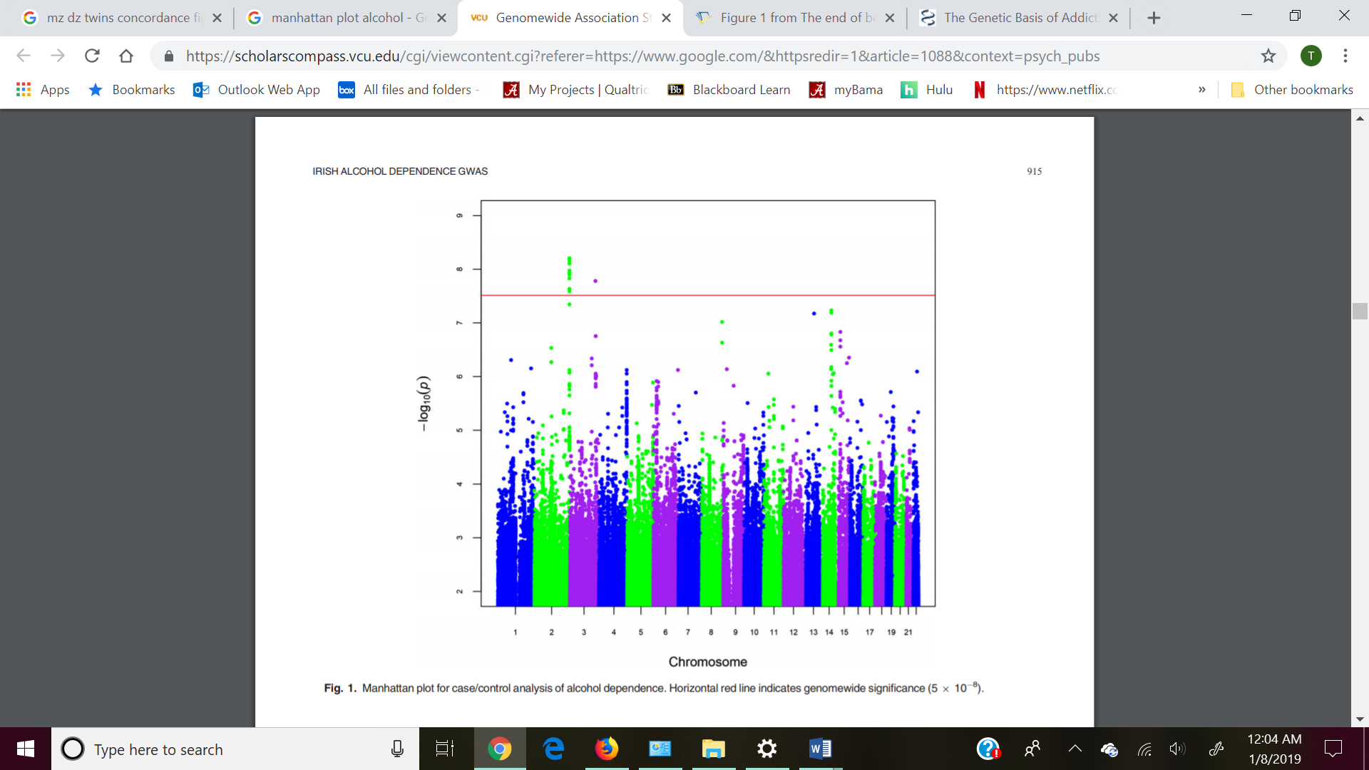
Want big impact? Use big image.

Slide 11
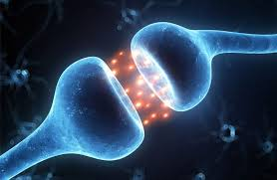
Research with genetics
Genetic factors up to 60% of addiction (Shuckit & Smith, 2001)
Genes that control dopamine type 4 receptors
Short and long
Long form: strong cravings for more alcohol
Gene that controls an enzyme that breaks down dopamine
More active: breaks down dopamine fast, decreases reinforcement, more impulsive behavior

Slide 12
Genetics of alcohol
Types of alcoholism
Type I: gradual onset, after 25; may of may not have relatives
Type II: rapid onset, before 25; most often men, close relatives with alcoholism
Sons of Alcoholics
High tolerance levels
Report more stress reduction from alcohol use
Small amygdala before developing alcoholism

Slide 13
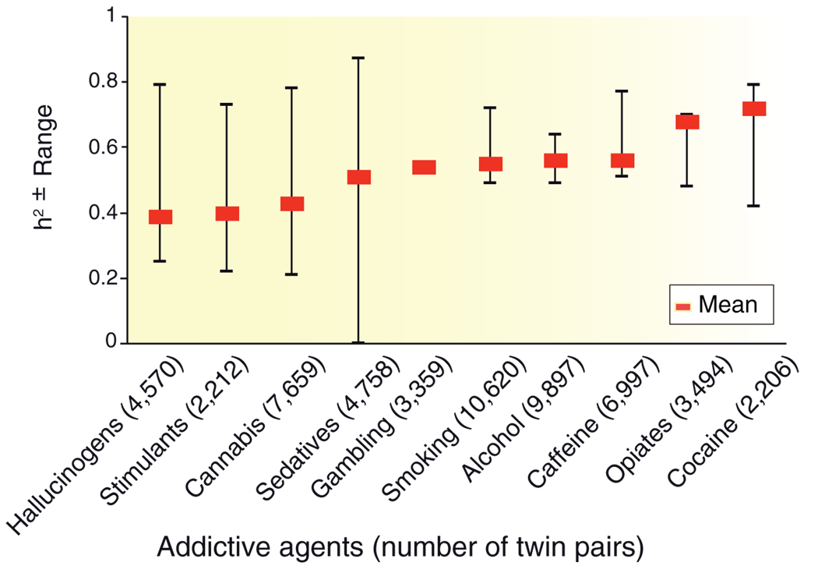
More genetics of addiction
Goldman D, Oroszi G, Ducci F. The genetics of addiction: uncovering the genes. Nat. Rev. Genet. 2005;6:521–532

Slide 14
Addiction questions
Will everyone with a genetic predisposition develop addiction?
What about environmental influences, do they play a role?
http://www.youtube.com/watch?v=ecdoHhj4MQU

Slide 15
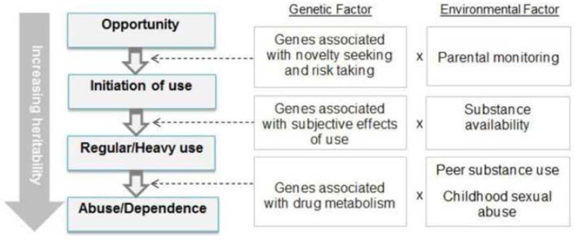
Environmental or genetic factors

