Slide 1
Peers, Family, & Culture

Slide 2
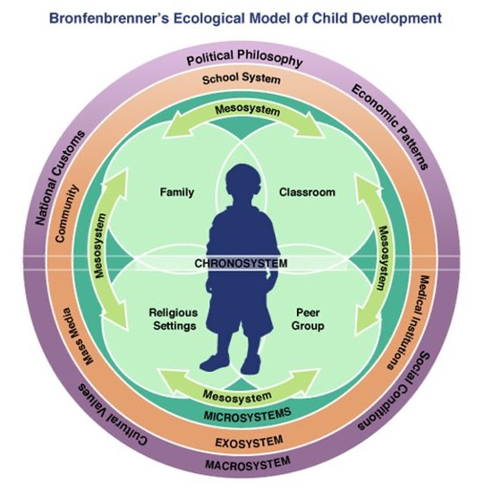
Bronfenbrenner’s Ecological Model of Child Development

Slide 3
Influence of Family
Early Exposure
Parental Modeling
Parental Favorable use
Parental Monitoring
Permissive
Uninvolved
ACEs in the home

Slide 4
Influence of Peer Groups
Friends who use
Selection or influence?
Friends with low academic competence
This Photo by Unknown Author is licensed under CC BY-NC-ND

Slide 5
Influence of Youth Culture
Youth culture: peers 12-18, social norms -> strong influence
Loyal: maintain association of the group
No adults allowed
Competition for prestige in the group -> new behavior

Slide 6
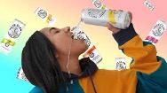
Influence of Media
Increased media exposure -> perception of social norms -> increased use
Targeted groups with advertisers
Adolescents more affected

Slide 7
Influence of Community and Culture
Neighborhood characteristics and opportunities to purchase or consume alcohol -> influence
Race, ethnicity, and culture influence substance use patterns

