Slide 1
Why does addiction persist over time? Why is it so hard to overcome?

Slide 2
What we will cover
Reinforcement
Cravings
Brain Changes
Tolerance & Withdrawal
Motives, Expectancies, etc.
Peers, Family, & Culture

Slide 3
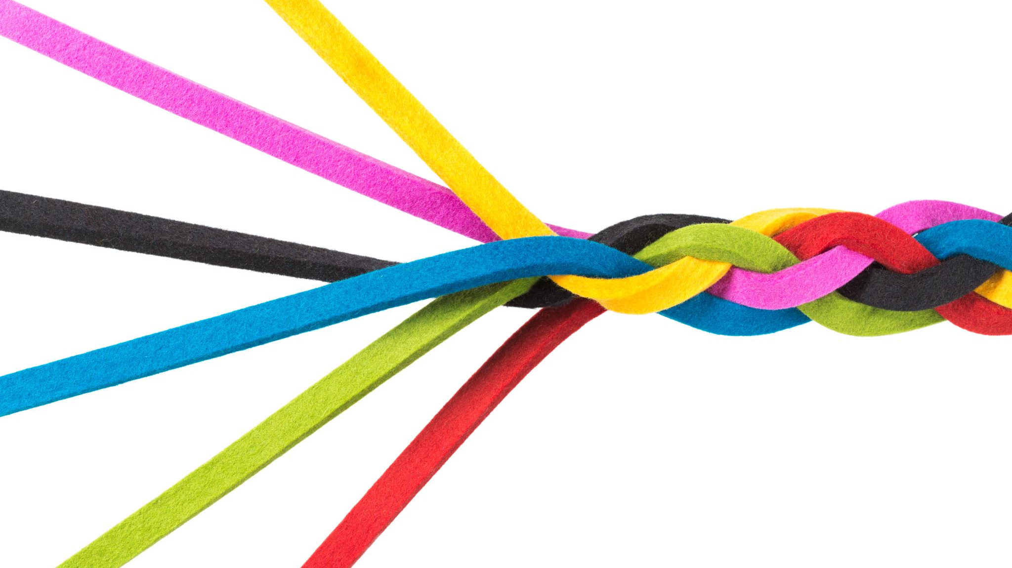
Reinforcement

Slide 4
Behaviors are shaped by rewards
All organisms will repeat a behavior if there is a reward.

Slide 5
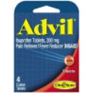
Behaviors are shaped by rewards
There are two types of rewards:
Positive reinforcement
Negative reinforcement

Slide 6
Behaviors are shaped by rewards
Some rewards are more powerful than others in shaping behavior.
Subjectively pleasing
Robust/potent
Immediate
Unexpected
High likelihood of occurring

Slide 7
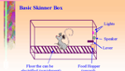
Behaviors are shaped by rewards
Operant Conditioning
A learning process where rewards (reinforcement and punishment) shape behavior.

Slide 8
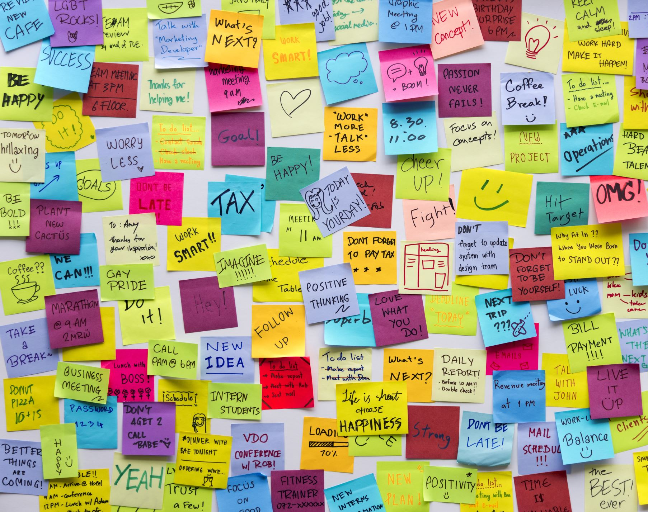
Schedules of Reinforcement
Continuous schedule of reinforcement: reward present each time you do a behavior.
Partial schedule of reinforcement: reward is present every once in a while, but not always.

Slide 9
Partial Schedules of Reinforcement
 | Time | Behavior
Set | Fixed Interval In 5 minutes if you open your microwave, you will find $50. | Fixed Ratio Every 5th time you open the microwave you will find $50.
Varies | Variable Interval At some point in the near future, if you open your microwave, you will find $50. (The time interval is around 5 minutes but not exact.) | Variable Raito Each time you open the microwave there is a chance you’ll find $50. (The number of times you open and find the cash will vary, approx. every 5 times.)

Slide 10
Each partial schedule produces a different pattern of behavior

Slide 11
Schedules of Reinforcement
Partial
Stops
Long-term behavior
Continuous
Stops
Short-term behavior

Slide 12
Addictions are Shaped are Shaped
Subjectively pleasing
Unexpectedly robust rewards
Immediate and powerful
Variable ratio schedule of reinforcement.
http://www.youtube.com/watch?v=I_ctJqjlrHA

