Slide 1
Why does addiction persist over time? Why is it so hard to overcome?

Slide 2
What we will cover
Reinforcement
Cravings
Brain Changes
Tolerance & Withdrawal
Motives, Expectancies, etc.
Peers, Family, & Culture

Slide 3
Tolerance & Withdrawal

Slide 4
Tolerance
Tolerance is the need to use increasingly greater amounts of a substance to obtain the desired effect.
Different effects of drugs
Does not last indefinitely
Tolerance to one drug may diminish the effect of another drug.

Slide 6
Metabolic Tolerance
Body begins to increase rate of metabolism to maintain homeostasis.
Ex. Body increases level of an enzyme that destroys the drug.
Influences ALL drug effects because of diminished concentration of the drug at the site of action.

Slide 7
Physiological or Cellular Tolerance
Adjustments at the cellular level to maintain homeostasis.
Body compensates for the drug once it enters the system to restore balance.
Ex. If the drug produces excess neurotransmitters in the synapse, body shuts down receptors

Slide 8
Behavioral Tolerance
Influence of environment via classical conditioning.
Cues in the environment help the body prepare BEFORE the drug enters the system.

Slide 9
Behavioral Tolerance
Repeated exposure to a drug -> person shown a cue -> body will show signs of ANTICIPATION, preparing for the drug.
Compensatory response
The body and brain attempt to counteract the effects when presented with environmental cues, before the drug enters system.
Produces urges for the drug.
Allowing people to ”handle” larger amounts of the drug.

Slide 10
Behavioral Tolerance
Siegal (1972) gave rats repeated injections of insulin.
Reducing the level of glucose in the blood.
Then he gave them an injections of saline and the needle was the conditioned stimulus.
Increase in blood glucose levels
A compensatory response: opposite of insulin’s effect.
The mind/body responded to the needle by anticipating insulin so it could maintain homeostasis.

Slide 11
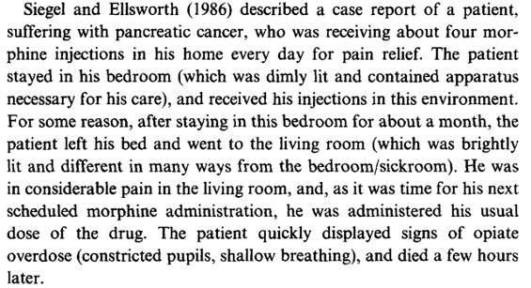
Case Report

Slide 12
Behavioral Tolerance
Some drugs show evidence of ”environment-dependent tolerance” vs environment-independence tolerance
Listen to an unexpected overdose: https://www.youtube.com/watch?v=ZoHFOR7sJpk

Slide 13
Withdrawal Symptoms
Drugs produce different symptoms when the drug leaves the body.
Opioids: chills, headaches, cramps, tremors, panic, loss of appetite, irritability, etc.
http://www.youtube.com/watch?v=NaMgdlUcsko
Caffeine: irritability, restlessness, headaches
LSD: none

Slide 14
Withdrawal Symptoms
Alcohol: sweating, vomiting, anxiety, insomnia, psychotic symptoms, convulsions, delirium tremens (extreme confusion), and death.
http://www.youtube.com/watch?v=291TBlwlP1c

