Slide 1
Treatment and Recovery

Slide 2
Principles of effective treatment
People need to have quick access to treatment.
Treatment should be tailored to fit individual needs. (No one-size-fits-all)
Counseling most common, but medications are often used as well.
Treatment should address possible mental disorders.
Treatment should be long term.

Slide 3
Typical treatment settings
Outpatient Treatment:
Intensive outpatient programs (IOP)
Patients come to the facility multiple times a week for counseling and educational seminars.
Residential Treatment:
Residential treatment are in live-in facilities.
Highly structured, goal is total abstinence and improved quality of life, Peer support is part of treatment
www.Youtube.com/watch?v=Pb777gJ_pC8

Slide 4
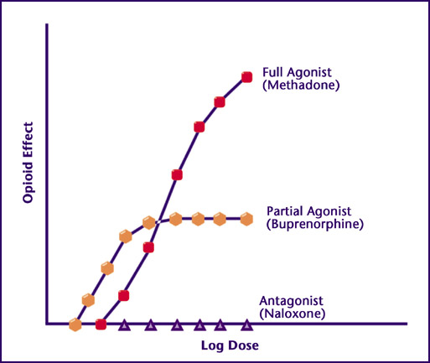
Medication options for OUD (opioid)
Agonists:
Methadone (full agonist)
Buprenorphine/suboxone (partial agonist)
Antagonists:
Naltrexone/Vivitrol
Naloxone/Narcan
www.youtube.com/watch?v=tMusvDyoIRI

Slide 5
Therapy/counseling options
Individual counseling:
Peer support/support group
Family therapy
Relapse prevention techniques

Slide 6
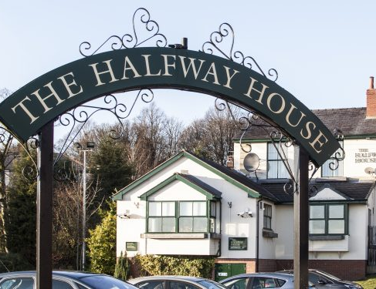
Long-term care options
Continuing care or aftercare services
Halfway housing and sober living facilities

Slide 7
Recovery
Recovery is not simply becoming sober – it is transformational.
Definition: Recovery from alcohol and drug problems is a process of change through which an individual achieves abstinence and improved heath, wellness, and quality of life.
Many believe recovery has stages/phases
Withdrawal –
Honeymoon –
Wall –
Maintenance –

Slide 8
Four dimensions of recovery
Health
Overcoming or managing disease of symptoms
Home
Stable and safe place to live

Slide 9
Four dimensions of recovery
Community
Relationships and social networks that provide support, love, and hope.
Purpose
Meaningful daily activities, such as job or family caregiving and the income and resources to participate in society.
http://www.youtube.com/watch?v=7brXG8emGxM

