Slide 1
Drug Use and Addiction

Slide 2
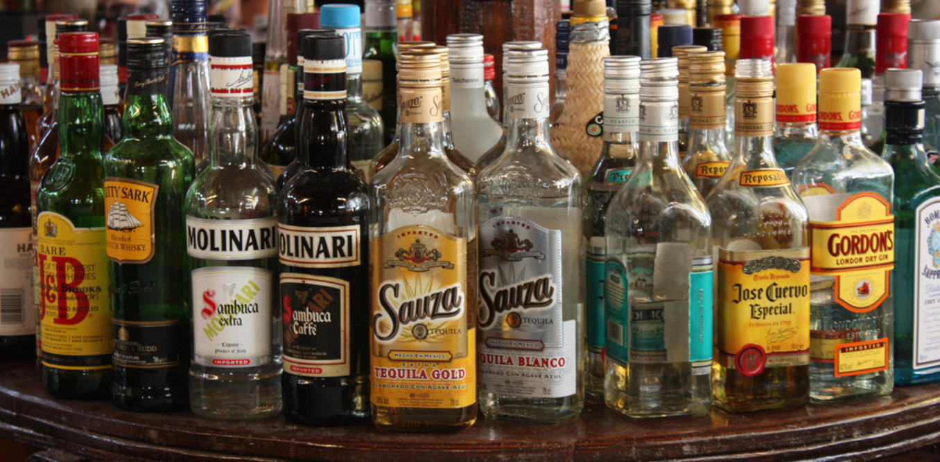
Addiction Terms
Tolerance
When you need more to get the same effect. A reduced reaction to a drug following repeated use.
Withdrawal
Symptoms that occur when a drug is reduced or stopped all together.
Overdose
Taking too much of a substance.
480,000
90,000

Slide 3
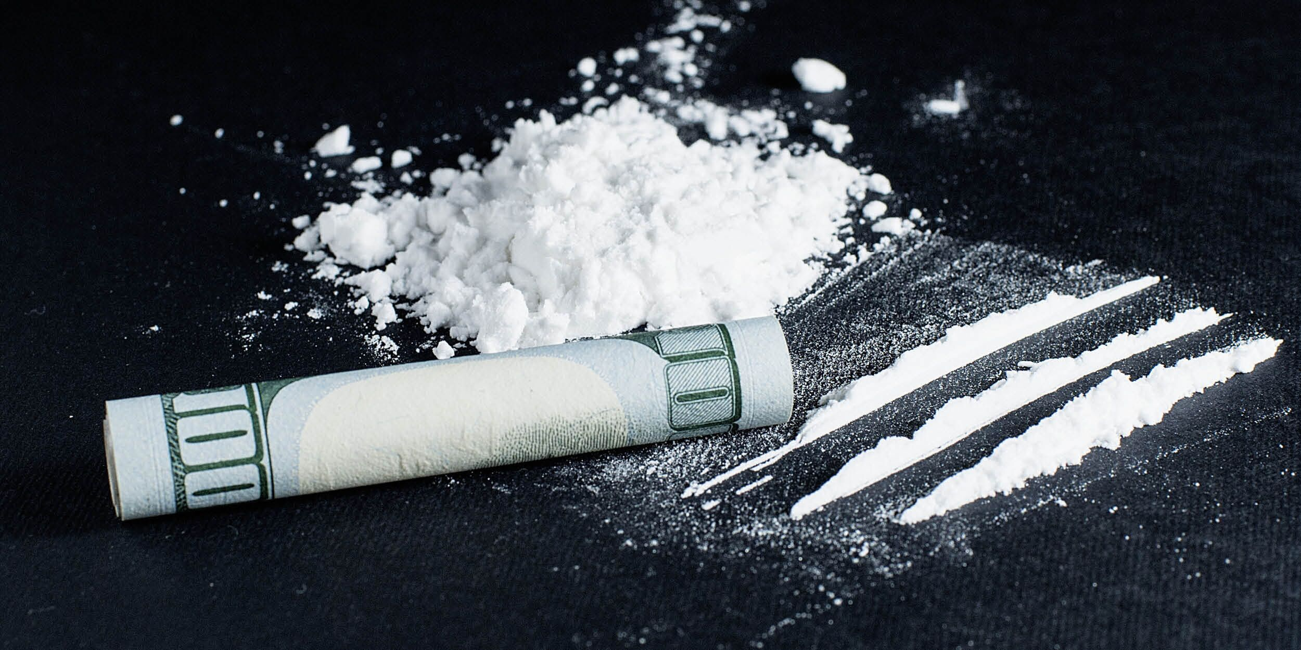
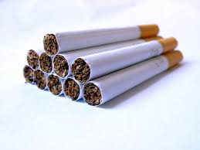
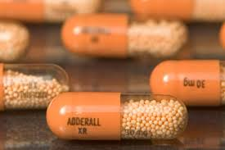
Uppers
Examples
Cocaine, methamphetamine, amphetamines (Adderall), caffeine, nicotine, narcolepsy medications, etc.
General Effects
Increases: blood pressure, heartrate, respiration, euphoria, alertness.
“Stimulates”
Addiction Potential
High addiction potential (nicotine)
Withdrawal not too intense; fatigue, increased appetite, depression.
Moderate overdose potential (cardiac arrest).

Slide 4
Uppers Videos
Crystal Meth: https://www.youtube.com/watch?v=fuyX1XKxX_s
Synthetic “Bath Salts”: https://www.youtube.com/watch?v=bXo-0iFj8Ys

Slide 5
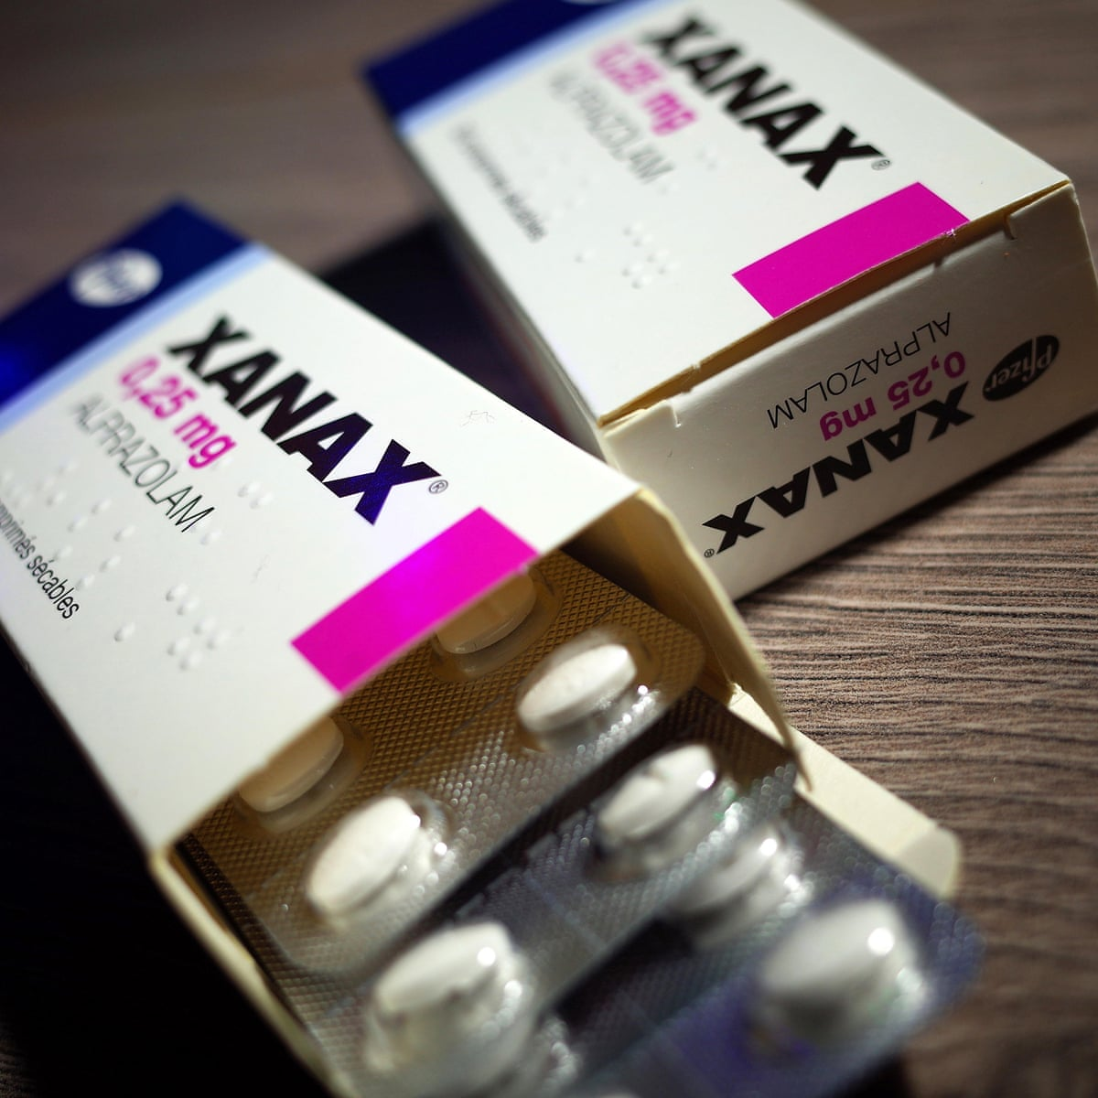
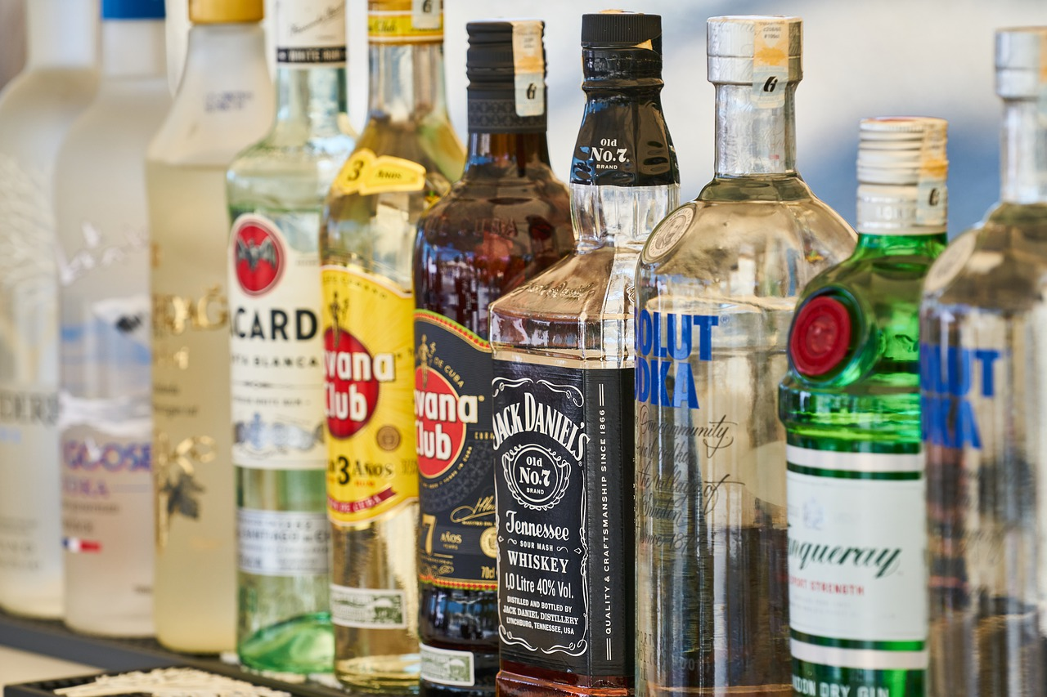
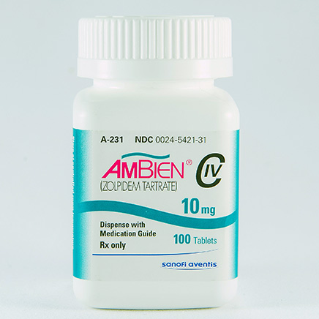
Downers
Examples
Alcohol, barbiturates, benzodiazepines (Xanax), sleep aids (Ambien)
General Effects
Sleepiness, relaxation, slurred speech, staggering gait, amnesia/blackouts, mood alterations, etc.
“depressants”
Addiction Potential
Mod to High potential for addiction.
Tolerance occurs with repeated use.
Overdose potential is high. Increased risk with multiples

Slide 6
Downers Withdrawal
Headaches, irritability, vomiting, hallucinations, seizures, and death
Withdrawal can be deadly!
Alcohol withdrawal > Heroin withdrawal
With overdose there is a risk of choking on vomit and respiration stopping.

Slide 7
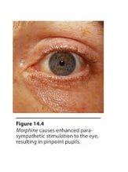
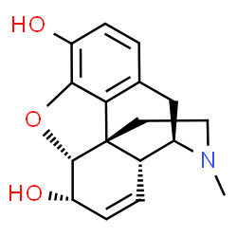
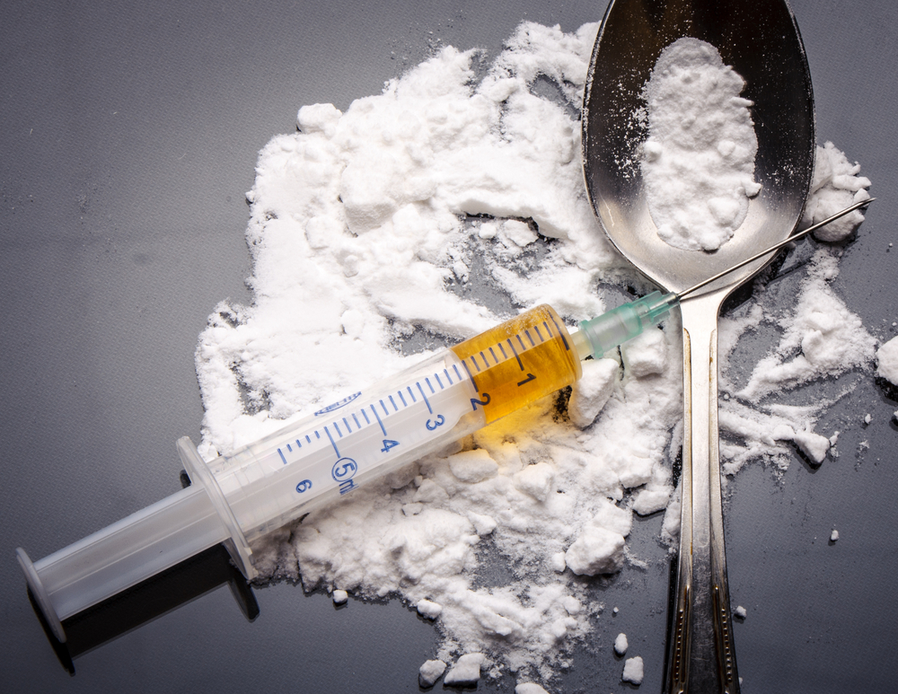
Opioids
Examples
Morphine, codeine, heroin, fentanyl, and pain pills(i.e. Vicodin, Lortab, etc.)
General Effects
Reduces pain, causes euphoria, drowsiness, constricts pupils. Can cause nausea (mostly the first time), vomiting, itching, and constipation.
Addiction Potential
High potential for addiction. Tolerance develops rapidly.
Withdrawal symptoms are severe – not deadly.
Overdose potential is high. Low – Mod use can cause death.

Slide 8
More on opioids
Narcan (naloxone) reverses overdose
Pills -> Heroin
https://www.youtube.com/watch?v=Nsjo7A1Bqj8

Slide 9
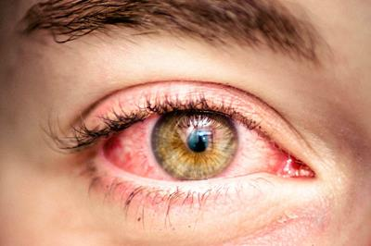
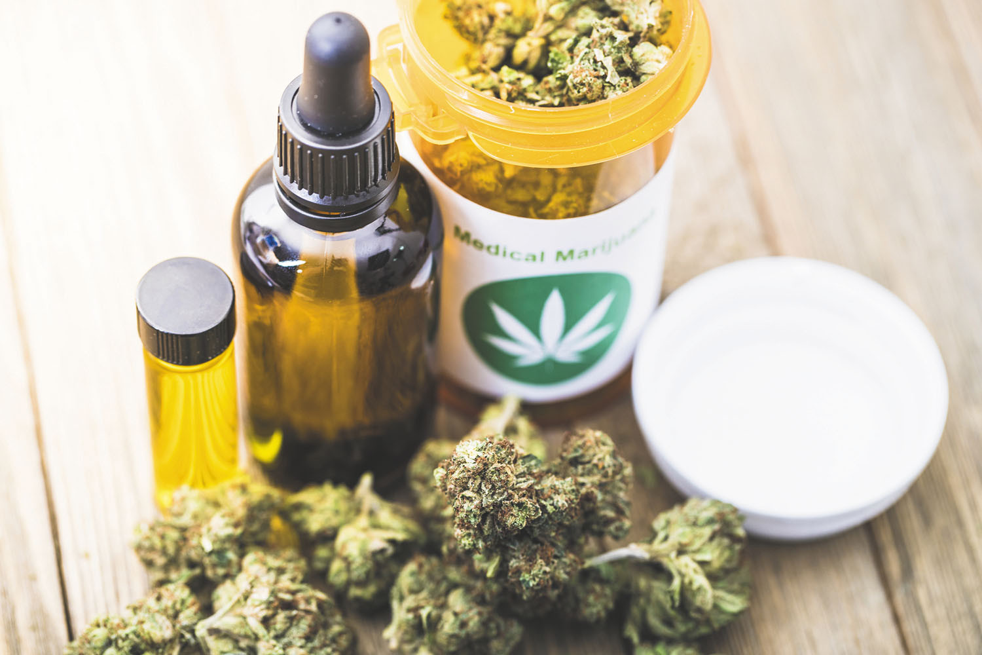
Marijuana/Cannabis
Examples
Marijuana, THC, Weed, K2/Spice, many, many other names.
General Effects
Enhanced sensory perception, increased euphoria, relaxation, drowsiness, slow reaction time, increase heart rate, more appetite, probs with memory and learning, can cause psychosis or hallucinations.
Addiction Potential
Moderate addiction potential, little to no tolerance or withdrawal.
Overdose potential is Low *

Slide 10
More on Cannabis
K2/Spice is a synthetic marijuana
The chemicals from the “potpourri”
https://www.youtube.com/watch?v=ArPDJZARUkI

Slide 11
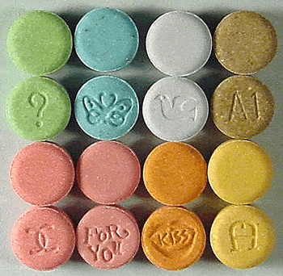
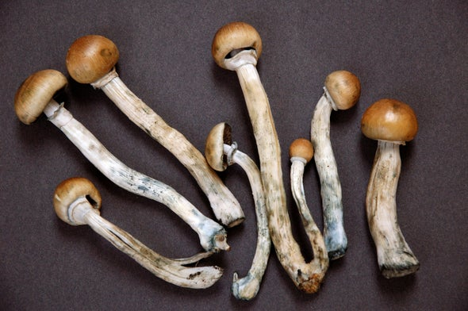
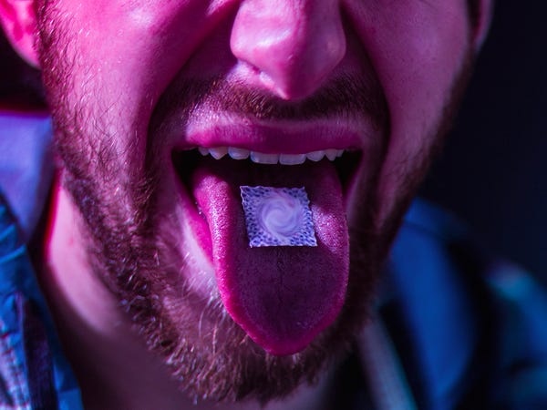
Hallucinogens
Examples
LSD (acid), psilocybin (mushrooms), mescaline, ketamine, MDMA/Ecstasy, Ayahuasca, Molly, PCP, etc.
General Effects
Effects vary. Mood and perceptual alterations, may cause insight and expanded consciousness or the opposite, discomfort and fear of losing control.
Addiction Potential
Most of these have no addiction potential. Minimal tolerance or withdrawal
Serotonin vs Dopamine

Slide 12
Addiction

Slide 13
What is addiction? Can you come up with a good definition after watching this video clip? ​
https://www.youtube.com/watch?v=-QXgQdmguK0

Slide 14
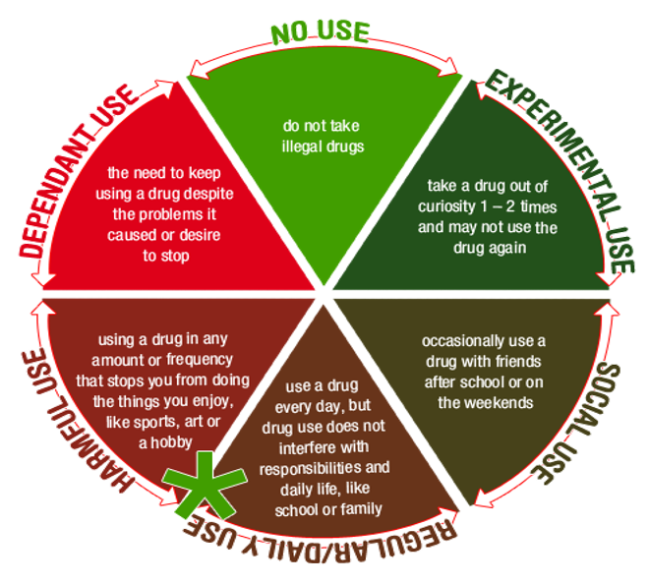

Slide 15
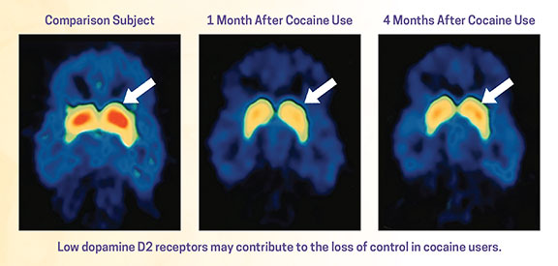
Defining Addiction
Dependent use
Physical vs Psychological
Examples
Psychological: the need, desire, continued use
Is drug use a choice?
State
Brain changes

Slide 16
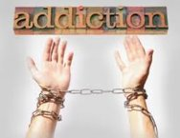
Addiction Definitions
Working Definition
3 C’s:
Craving or compulsion
Losing control over behavior
Continued use despite consequences.
National Institute of Addiction Medicine (NIDA)
“a chronic, relapsing brain disease that is characterized by compulsive drug seeking and use, despite harmful consequences.”

Slide 17
Addiction Definitions
American Society of Addiction Medicine
”Addiction is a treatable, chronic medical disease involving complex interactions among brain circuits, genetics, the environment, and an individual’s life experiences. People with addiction use substances or engage in behaviors that become compulsive and often continue despite harmful consequences.”
Prevention efforts and treatment approaches for addiction are generally as successful as those for other chronic diseases.

Slide 18
Diagnosing Addiction
Is addiction an official mental health diagnosis?
Substance use disorder (with type of substance)
Mild (2-3 symptoms), Moderate (4-5 symptoms), and Severe (6+ symptoms)

Slide 19
1) The substance is often taken in larger amounts or over a longer period than was intended.​
2) There is a persistent desire or unsuccessful effort to cut down or control use.​
3) A great deal of time is spent in activities necessary to obtain the substance, use the substance, or recover.​
4) Craving, or a strong desire or urge to use the substance.​
5) Recurrent use of the substance resulting in a failure to fulfill major role obligations at work/school/home.​
6) Continued use of the substance despite having persistent or recurrent social or interpersonal problems caused or exacerbated by the effects of its use.​
7) Important social, occupational, or recreational activities are given up or reduced because of use.​
8) Recurrent use of the substance in situations in which it is physically hazardous.​
9) Use of the substance is continued despite knowledge of having a persistent or recurrent physical or psychological problem that is likely to have been caused or exacerbated by the substance.​
10) Tolerance, as defined by either of the following: ​
A need for markedly increased amounts of the substance to achieve intoxication or desired effect.​
A markedly diminished effect with continued use of the same amount of the substance​
11) Withdrawal, as manifested by either of the following: ​
The characteristic withdrawal syndrome for that substance​
The substance (or a related substance) is taken to relieve or avoid withdrawal symptoms
https://www.youtube.com/watch?v=UiGLn390dWU

