Slide 1
Why does addiction persist over time? Why is it so hard to overcome?

Slide 2
What we will cover
Reinforcement
Cravings
Brain Changes
Tolerance & Withdrawal
Motives, Expectancies, etc.
Peers, Family, & Culture

Slide 3
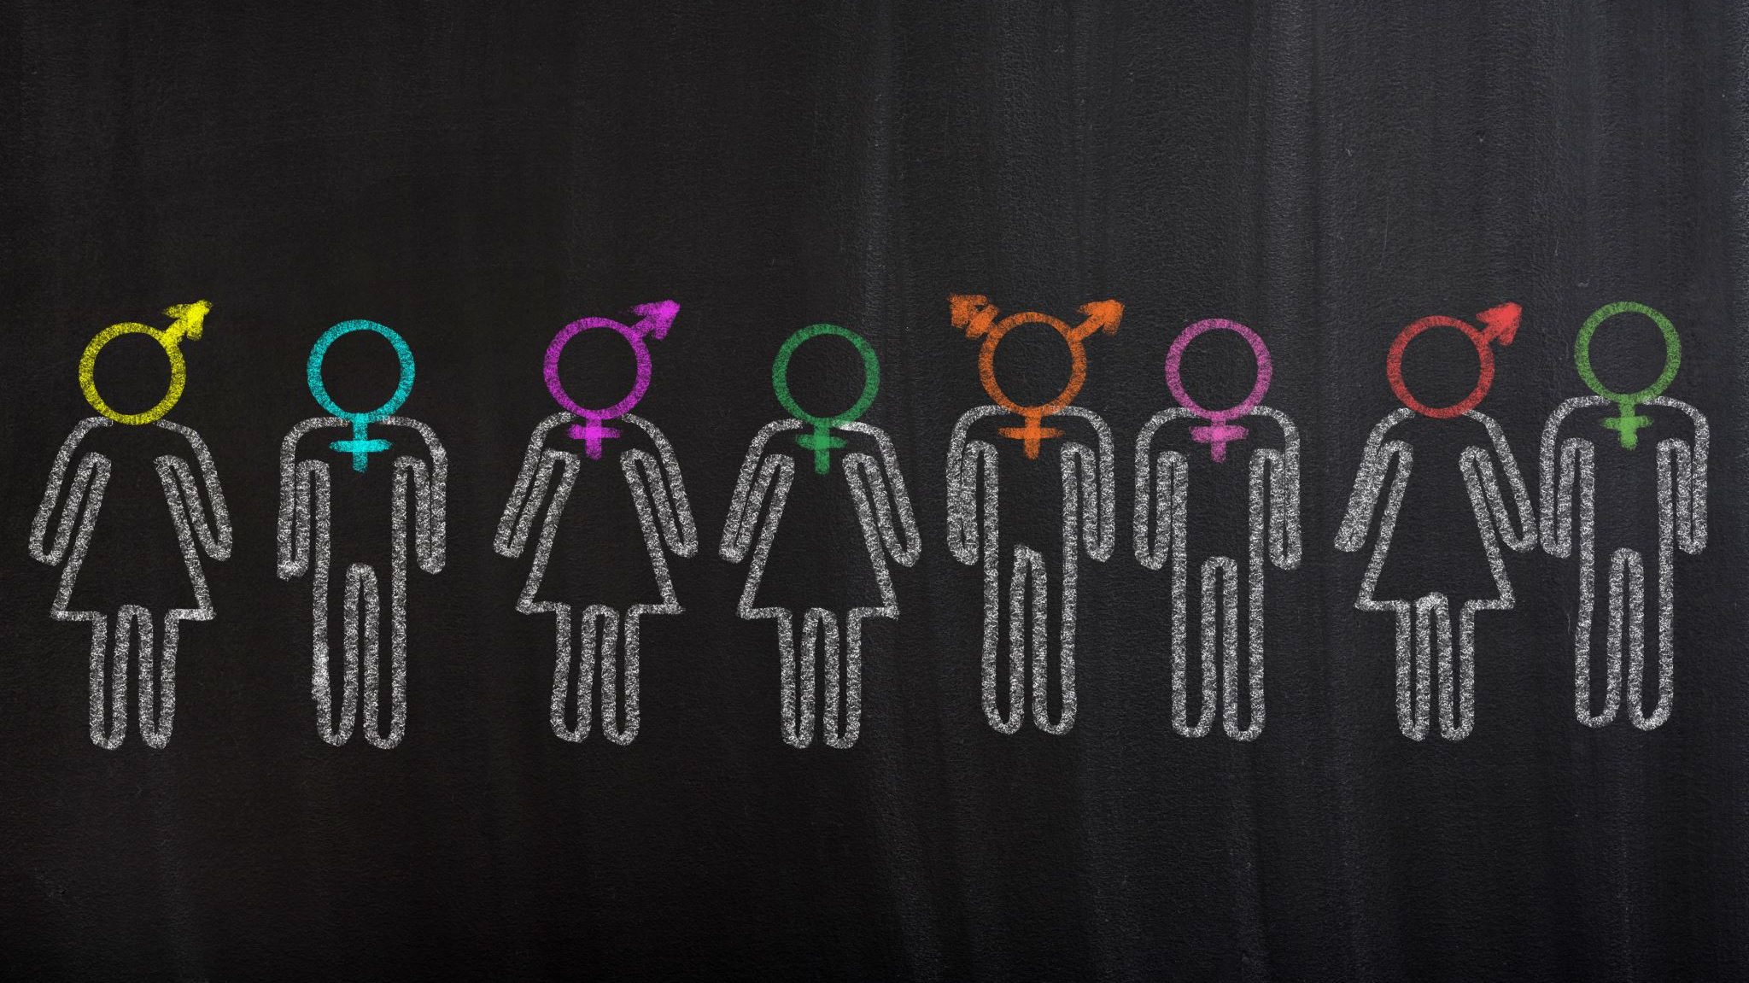
Family, Peers, & Culture

Slide 4
Family Systems Theory
Family dynamics of addiction
Members operate like an interdependent system. Change in one will affect the whole
The system will always try to seek a balance or homeostasis.

Slide 5
Family Systems Theory
Roles: will develop to maintain homeostasis
Ex:
Rules: will develop to maintain homeostasis
Ex:

Slide 6
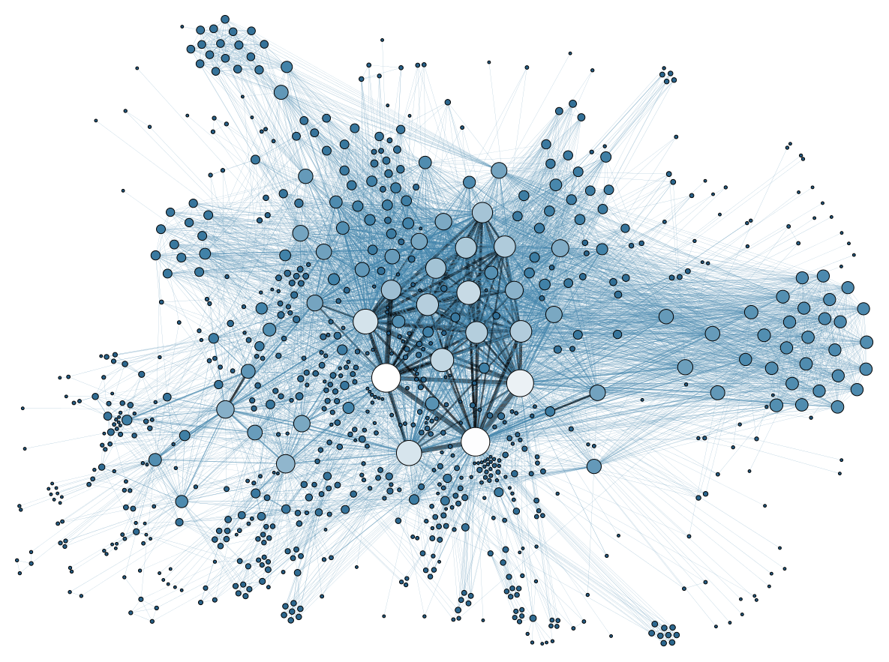
Social Network Theory
Members of a social network can influence each other through persuasion, sharing info, and passing on trends
Each individual is called a node.
May have a power position w/i network
Critical role of transmission of trends
Social networks -> important driver of health behaviors
https://www.youtube.com/watch?v=xT3EpF2EsbQ

Slide 7
Subcultures
Social network < Subculture
Individuals w/i the subculture have shared interests and have their own values and norms.
Ex
Alcohol and drugs can be used to create a subculture.
There is strong loyalty to the subculture and a sense of belongingness keeping them connected.

Slide 8
Subcultures
Alcohol subculture: Greek organizations often have an emphasis in the excessive consumption, including drinking games and drinking styles.
Polysubstance subculture: Expected to use any substance to alter consciousness. Sharing drugs, combinations of drugs, rave and after-party scene, etc.
Heroin subculture: http://www.youtube.com/watch?v=wptaluGbBhM

